Slide 1
Algorithm Design & Analysis Introduction to Algorithm
Chapter 2: Getting Started: Analyzing Algorithms
《算法分析与设计》课程组
重庆大学计算机学院
Notes:
In Chapter 2, we see our first algorithms, which solve the problem of sorting a sequence of n numbers. They are written in a pseudocode which, although not directly translatable to any conventional programming language, conveys the structure of the algorithm clearly enough that a competent programmer can implement it in the language of his choice. The sorting algorithms we examine are insertion sort, which uses an incremental approach, and merge sort, which uses a recursive technique known as "divide and conquer." Although the time each requires increases with the value of n, the rate of increase differs between the two algorithms. We determine these running times in Chapter 2, and we develop a useful notation to express them.

Slide 2
Getting Started: Analyzing Algorithms
OUTLINE
2.0 Analysis of algorithms: Why & What?
2.1 Insertion Sort: Example!
Description & analyzing algorithms?
2.2 Analyzing algorithms: How?
2.3 Designing algorithms: How?
Divide-and-Conquer
Merge Sort
Time complexity for Divide-and-Conquer
Notes:
2

Slide 3
2.0 Analysis of algorithms
What are analysis of algorithms?
The theoretical study of computer-program performance and resource usage.
What’s more important than performance?
Modularity • correctness • maintainability
Functionality • robustness • user-friendliness
programmer time • simplicity vs. time-complexity
extensibility
reliability

Slide 4
Criteria for analysis of algorithms
We will use the following criteria:
Correctness
Amount of work done
Amount of space used
Simplicity
Optimality

Slide 5
Correctness
Correctness:
An algorithm is correct if when given a valid input it computes for a finite amount of time and produces the right answer.
This definition is helpful if we know what the valid inputs are and what “the right answer” is.
Thus showing that an algorithm is correct means making a precise statement about what result it is to produce when given certain specified inputs, and then proving the statement.
Loop invariant

Slide 6
Loop Invariant
We often use a loop invariant to help us understand why an algorithm gives the correct answer. To use a loop invariant to prove correctness, we must show three things about it:
Initialization: It is true prior to the Þrst iteration of the loop.
Maintenance: If it is true before an iteration of the loop, it remains true before the next iteration.
Termination: When the loop terminates, the invariant. usually along with the reason that the loop terminated-- gives us a useful property that helps show that the algorithm is correct.

Slide 7
Loop Invariant
Using loop invariants is like mathematical induction:
Initialization: To prove that a property holds, you prove a base case and an inductive step.
Maintenance:Showing that the invariant holds before the first iteration is like the base case. Showing that the invariant holds from iteration to iteration is like the inductive step.
Termination: The termination part differs from the usual use of mathematical induction, in which the inductive step is used inÞnitely. We stop the induction. when the loop terminates.

Slide 8
Amount of work down: Efficiency
Run time = depend on the follow factors:
Computing model: RAM (random-access machine): How many computers?
In the RAM model, instructions are executed one after another, with no concurrent operations.
Instructions contained in RAM model
Machine: CPU How fast is the computer?
Input: Scale of instance How many data?
Number of basic operations done

Slide 9
RAM
• Instructions are executed one after another. No concurrent operations.
• It’s too tedious to define each of the instructions and their associated time costs. Instead, we recognize that we use instructions commonly found in real computers:
Arithmetic: add, subtract, multiply, divide, remainder, ßoor, ceiling). Also,shift left/right (good for multiplying/dividing by 2k ).
Data movement: load, store, copy.
Control: conditional/unconditional branch, subroutine call and return.
Each of these instructions takes a constant amount of time.

Slide 10
RAM
The RAM model uses integer and foating-point types.
We don’t worry about precision, although it is crucial in certain numerical applications.
There is a limit on the word size: when working with inputs of size n, assume that integers are represented by c lgn bits for some constant c ≥ 1.
c ≥ 1⇒ we can hold the value of n ⇒we can index the individual elements.
c is a constant ⇒the word size cannot grow arbitrarily.

Slide 11
Computing time
The time taken by an algorithm depends on the input.
Sorting 1000 numbers takes longer than sorting 3 numbers.
A given sorting algorithm may even take differing amounts of time on two inputs of the same size. For example, we’ll see that insertion sort takes less time to sort n elements when they are already sorted than when they are in reverse sorted order.

Slide 12
Computing run time
Run time formulation:
Input: What kind of input? I
Size of input: How many datum? n=|I|
Machine: CPU How fast is the machine? v1,…,vk处理第i种基本操作的速度
Computing model: RAM (random-access machine): How many machines? One only
Guarantee : Generally, we seek upper bounds on the running time, because everybody likes a guarantee max
Run time decided by: number of basic operations done and cpu speed
Run time: t = sum{n1/v1+…+nk/vk}

Slide 13
Amount of space used
The number of memory cells used by a program:
Prediction of the adequacy of memory space for running a program
Allocation of memory for programs in multiuser system
Estimation of the size of the problems that can be solved

Slide 14
Simplicity
Simplicity
It is often, though not always, the case that the simplest and most straightforward way of solving a problem is not the most efficient. Yet simplicity in an algorithm is a desirable feature.
It may make verifying the correctness of the algorithm easier, and it makes writing, debugging, and modifying a program for the algorithm easier.
The time needed to produce a debugged program should be considered when choosing an algorithm, but if the program is to be used very often, its efficiency will probably be the determining factor in the choice.

Slide 15
Optimality
We say that an algorithm is optimal (in the worst case) if there is no algorithm in the class under study that performs fewer basic operations (in the worst case). Bound
How would you know it?

Slide 16
2.1 Insertion Sort
The problem of sorting: Description
Insertion sort: Algorithm description

Slide 17
The Problem of sorting: Description
Sorting problem:
Input: A sequence of n numbers a₁, a₂, ..., a_{n}
Output: A permutation (reordering) a'₁, a'₂, ..., a'_{n} of the input sequence such that
a'₁≤ a'₂ ≤ ... ≤ a'_{n}
An instance of the sorting problem
Input: 8 2 4 9 3 6
Output: 2 3 4 6 8 9
Notation:
Sorting is a fundamental operation in CS
A large number of good sorting algorithms have been D&R

Slide 18
Game: Sorting a hand of cards?
Game
Task: Sorting a hand of cards
Input: a suit of play cards
Output: sorted cards
Requirement: as Fast as possible?
Report: The sorting method | algorithm?

Slide 19
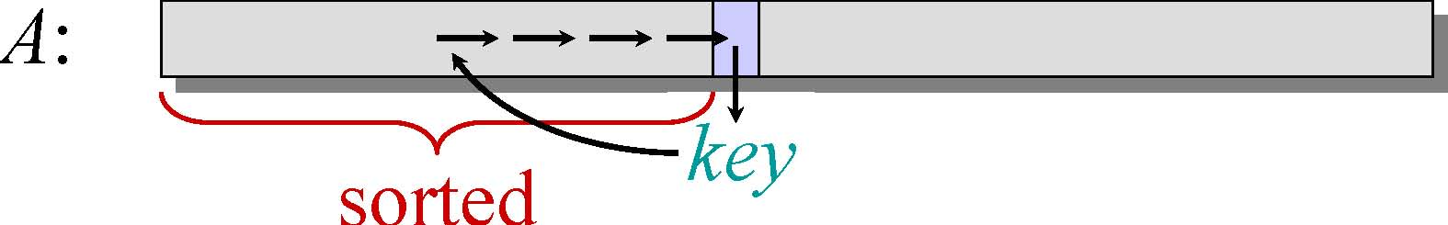
Example of insertion sort
8 2 4 9 3 6
• Initialization:
• Maintenance:
Insert A[j] into the sorted sequence A[1 j - 1].
• Termination:
• Why an algorithm is correct？ Induction

Slide 20
Insertion sort: Algorithm description
INSERTION-SORT (A, n) // A[1 . . n]
“pseudocode”
for j ← 2 to n 第一个长度为1的子序列已经排好
do key ← A[ j]
// Insert A[j] into the sorted sequence A[1 j - 1].
i ← j – 1
while i > 0 and A[i] > key
do A[i+1] ← A[i]后移一位为key留出位置
i ← i – 1
A[i+1] = key

Slide 21
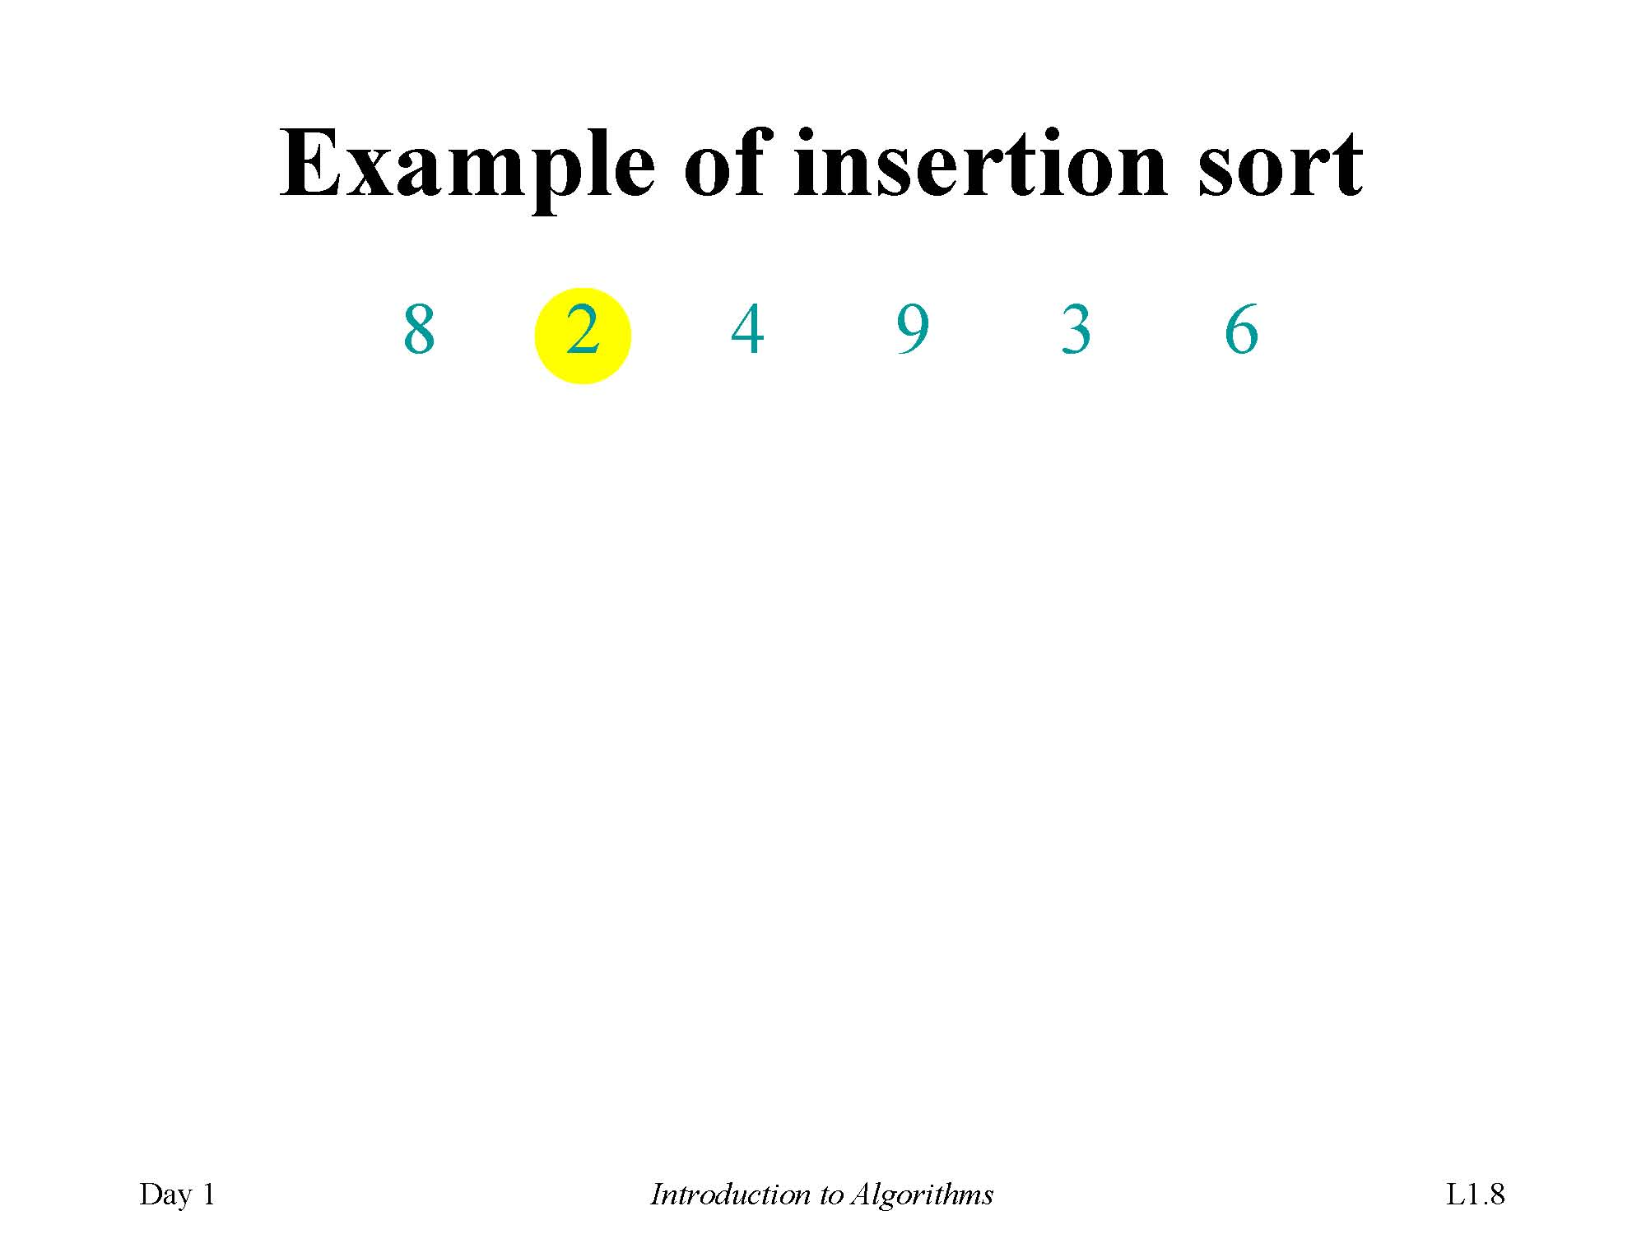
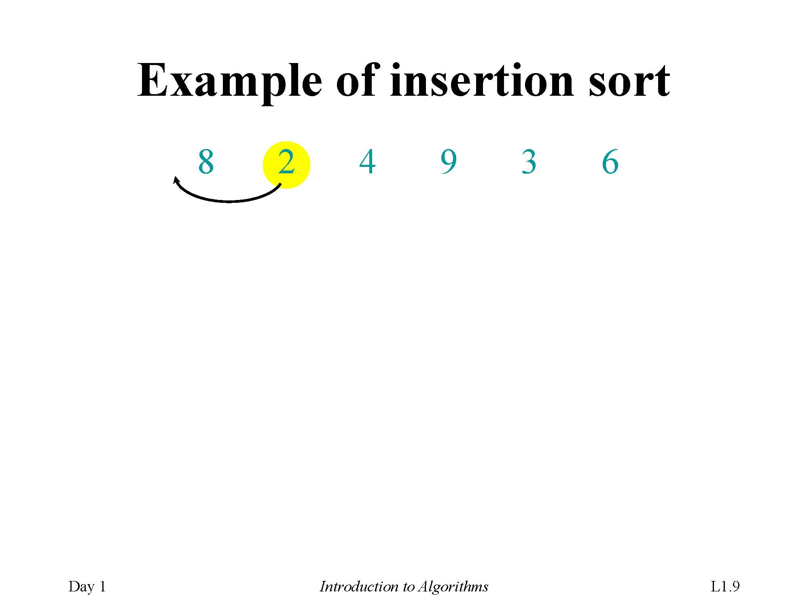
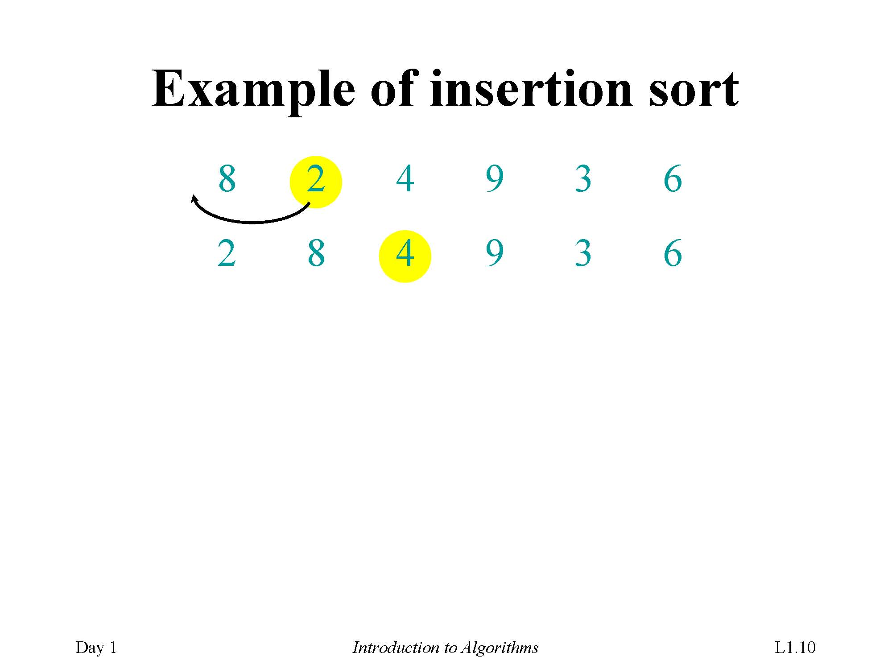
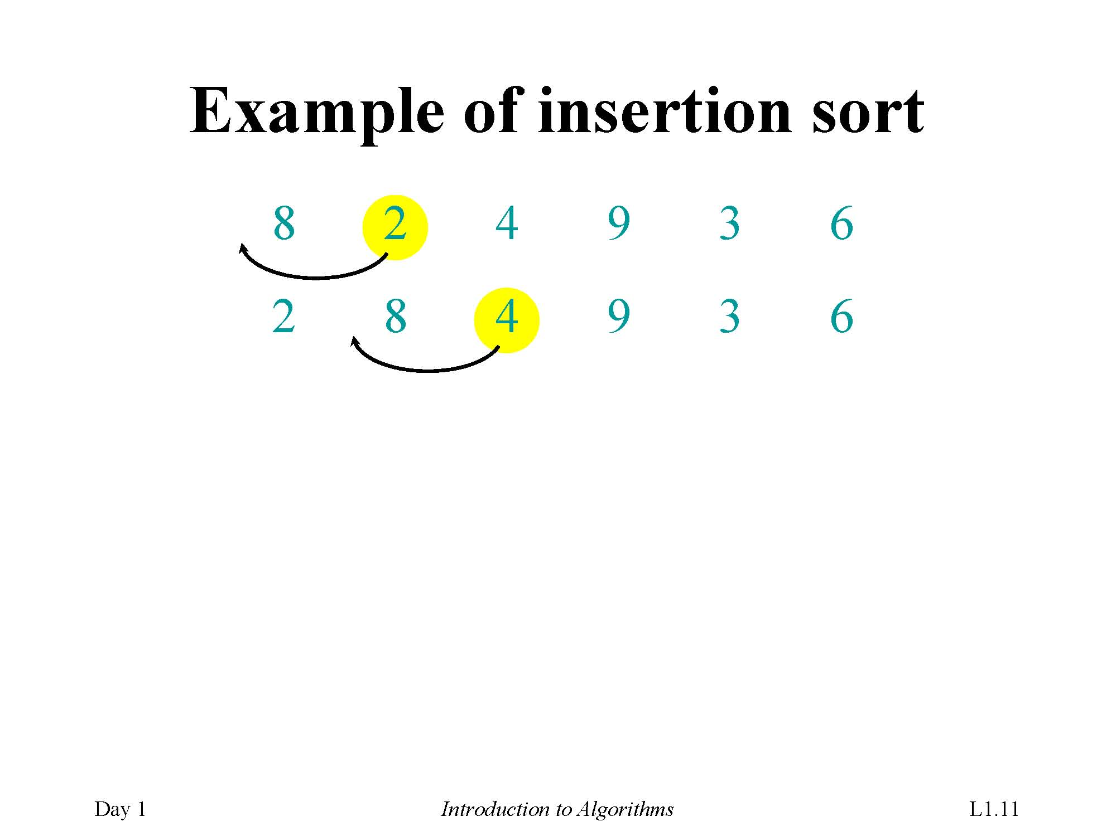
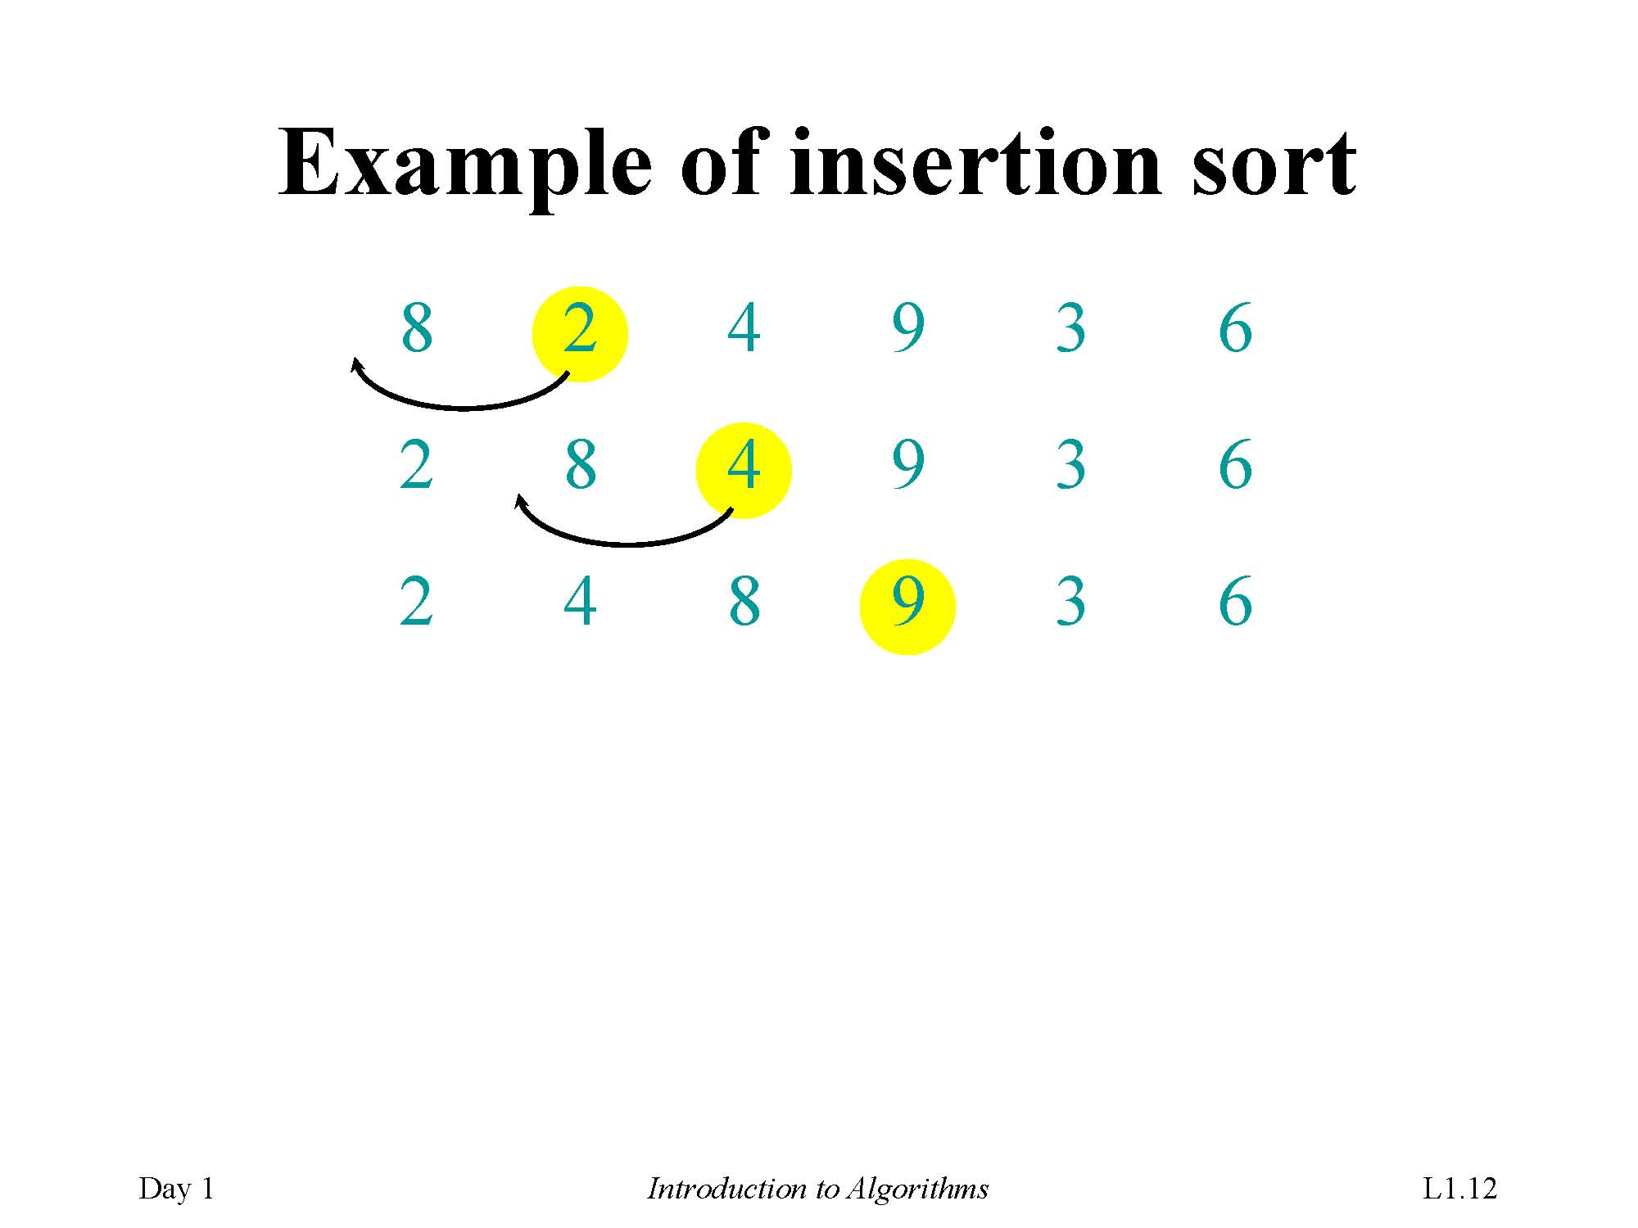
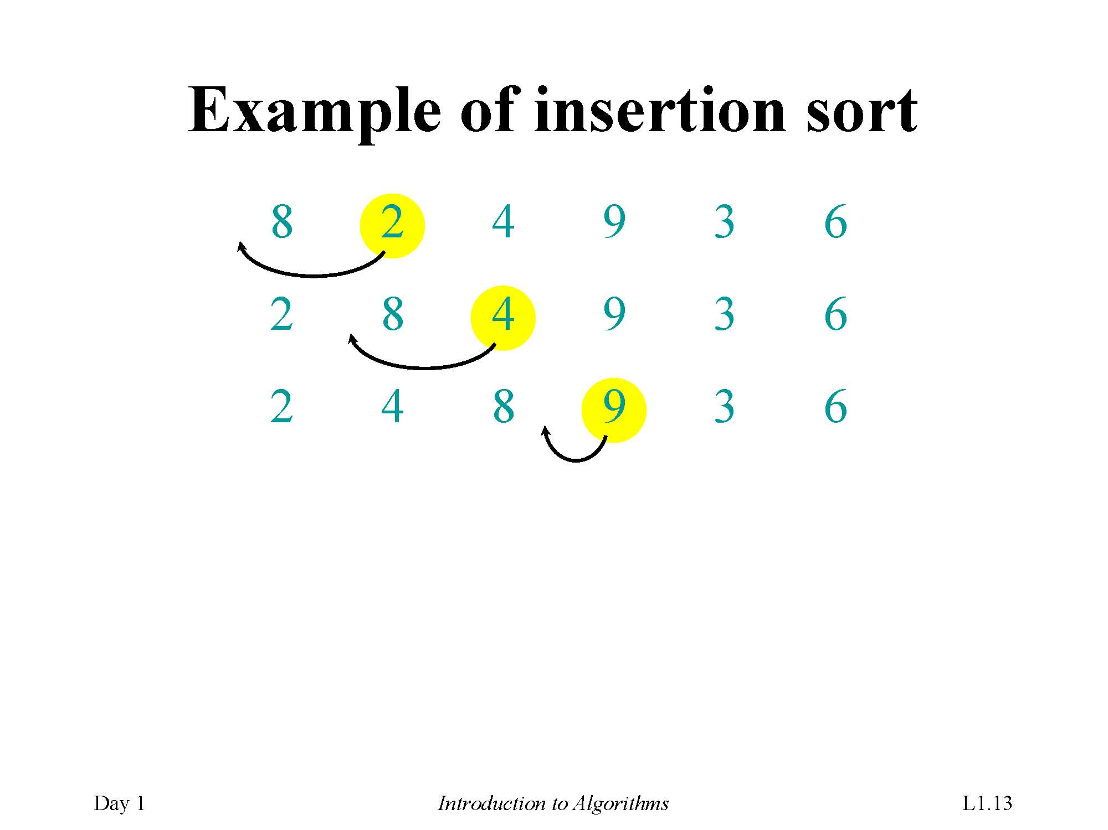
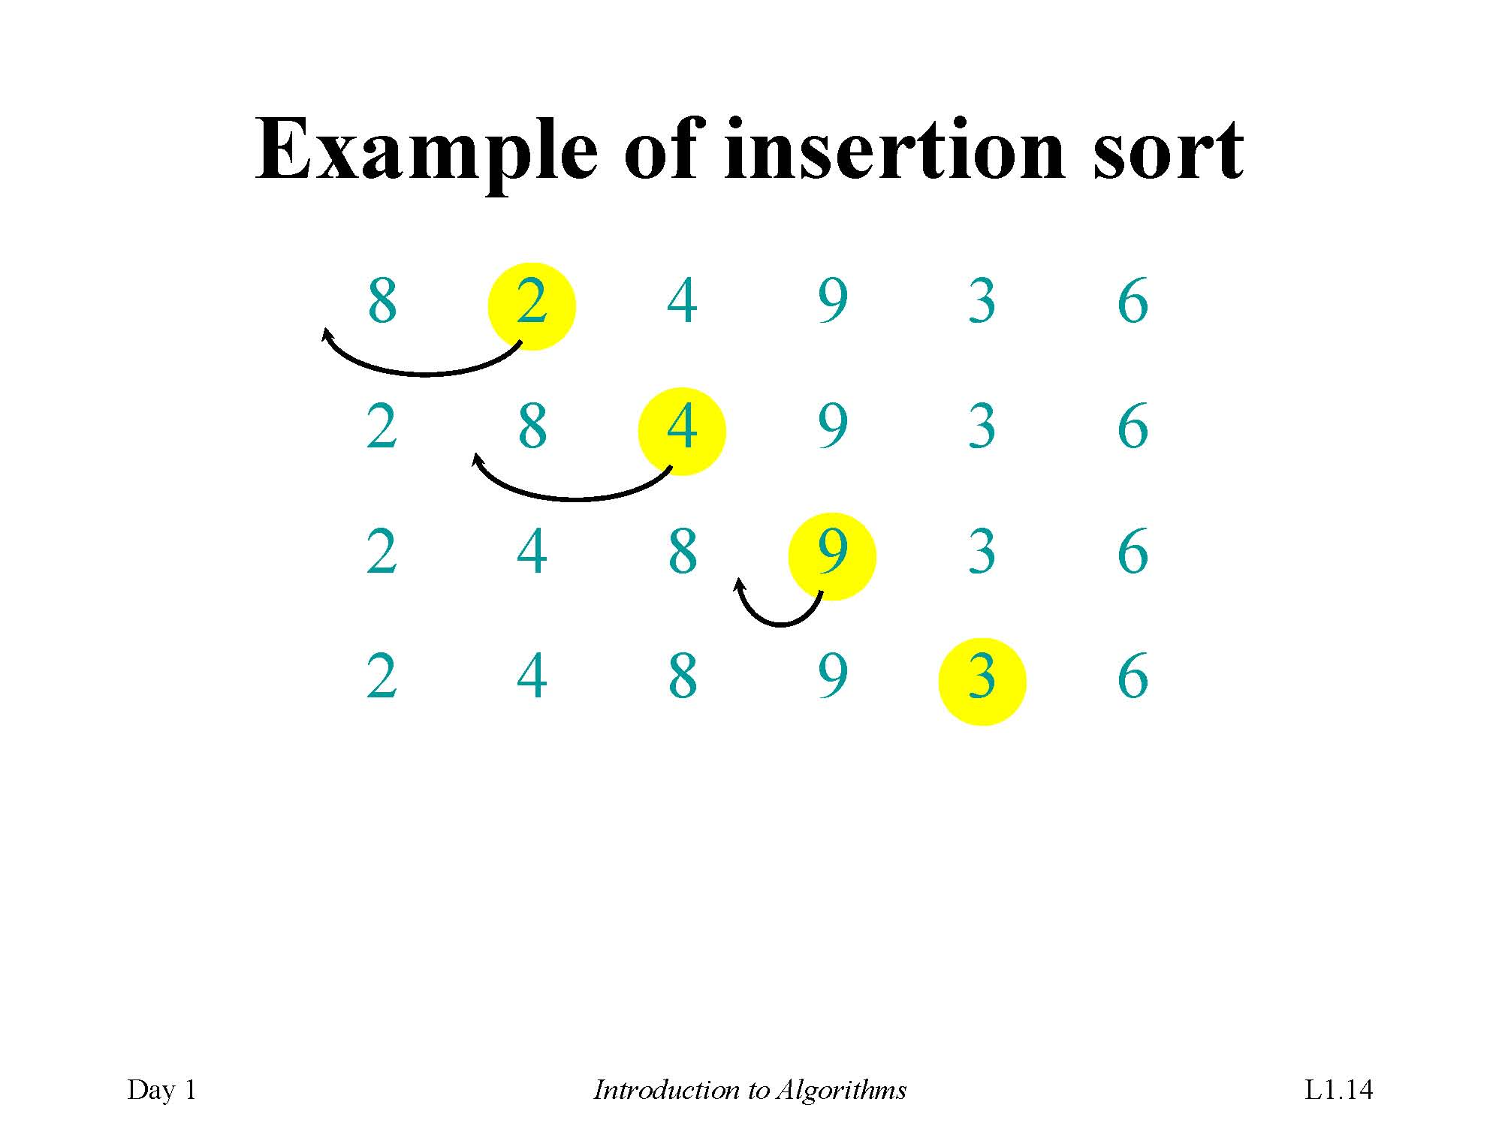
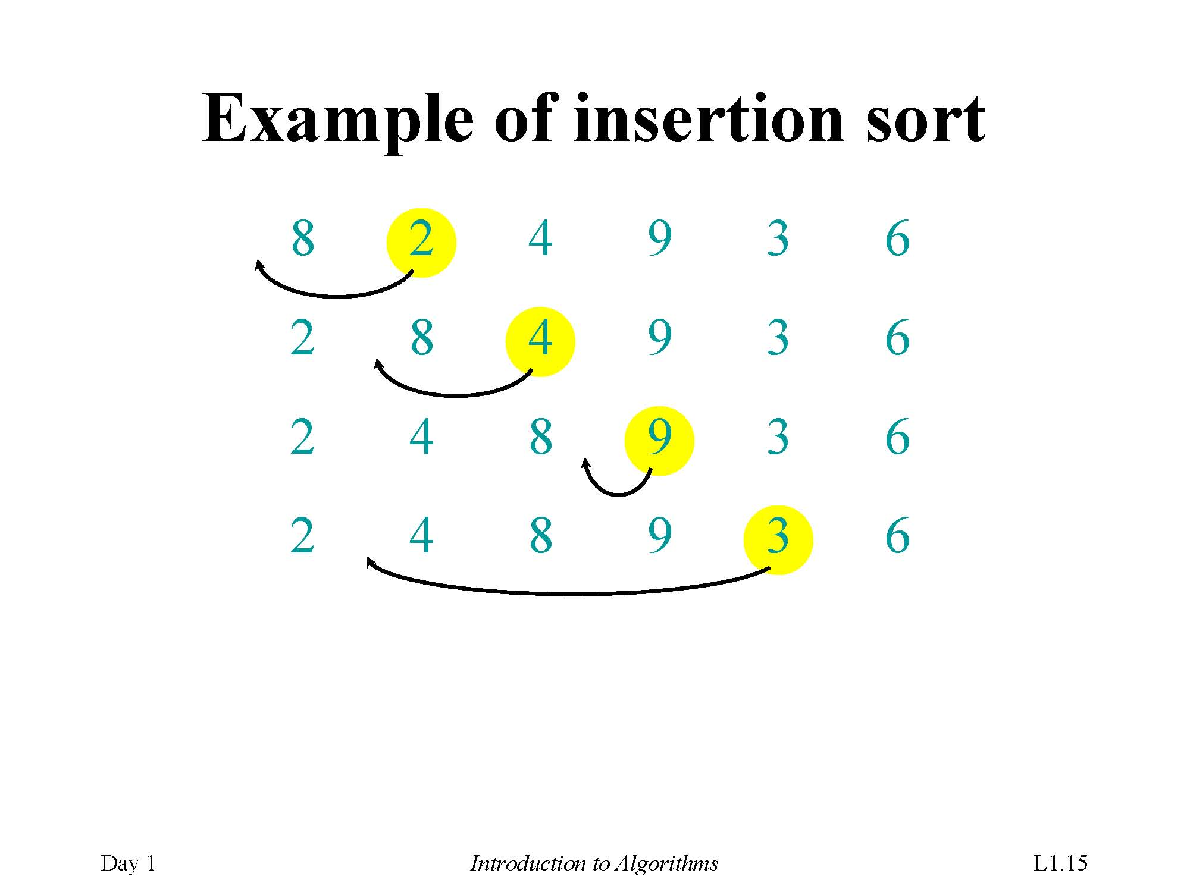
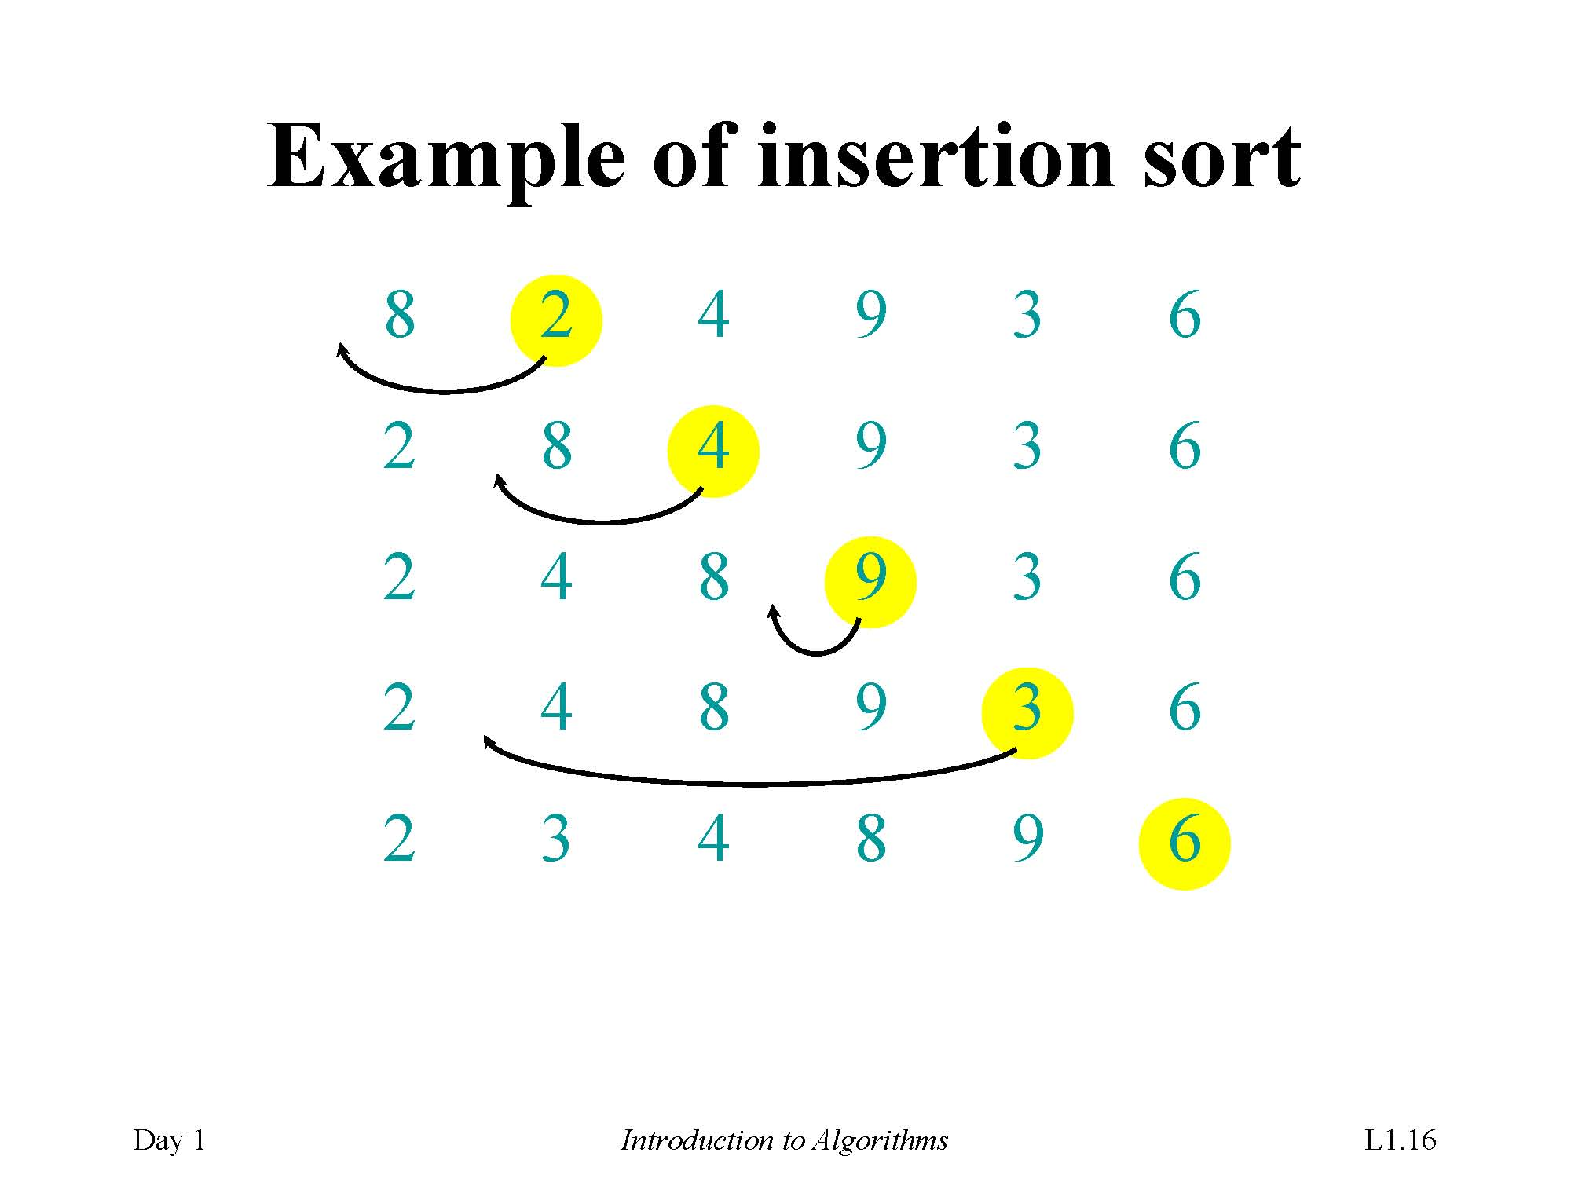
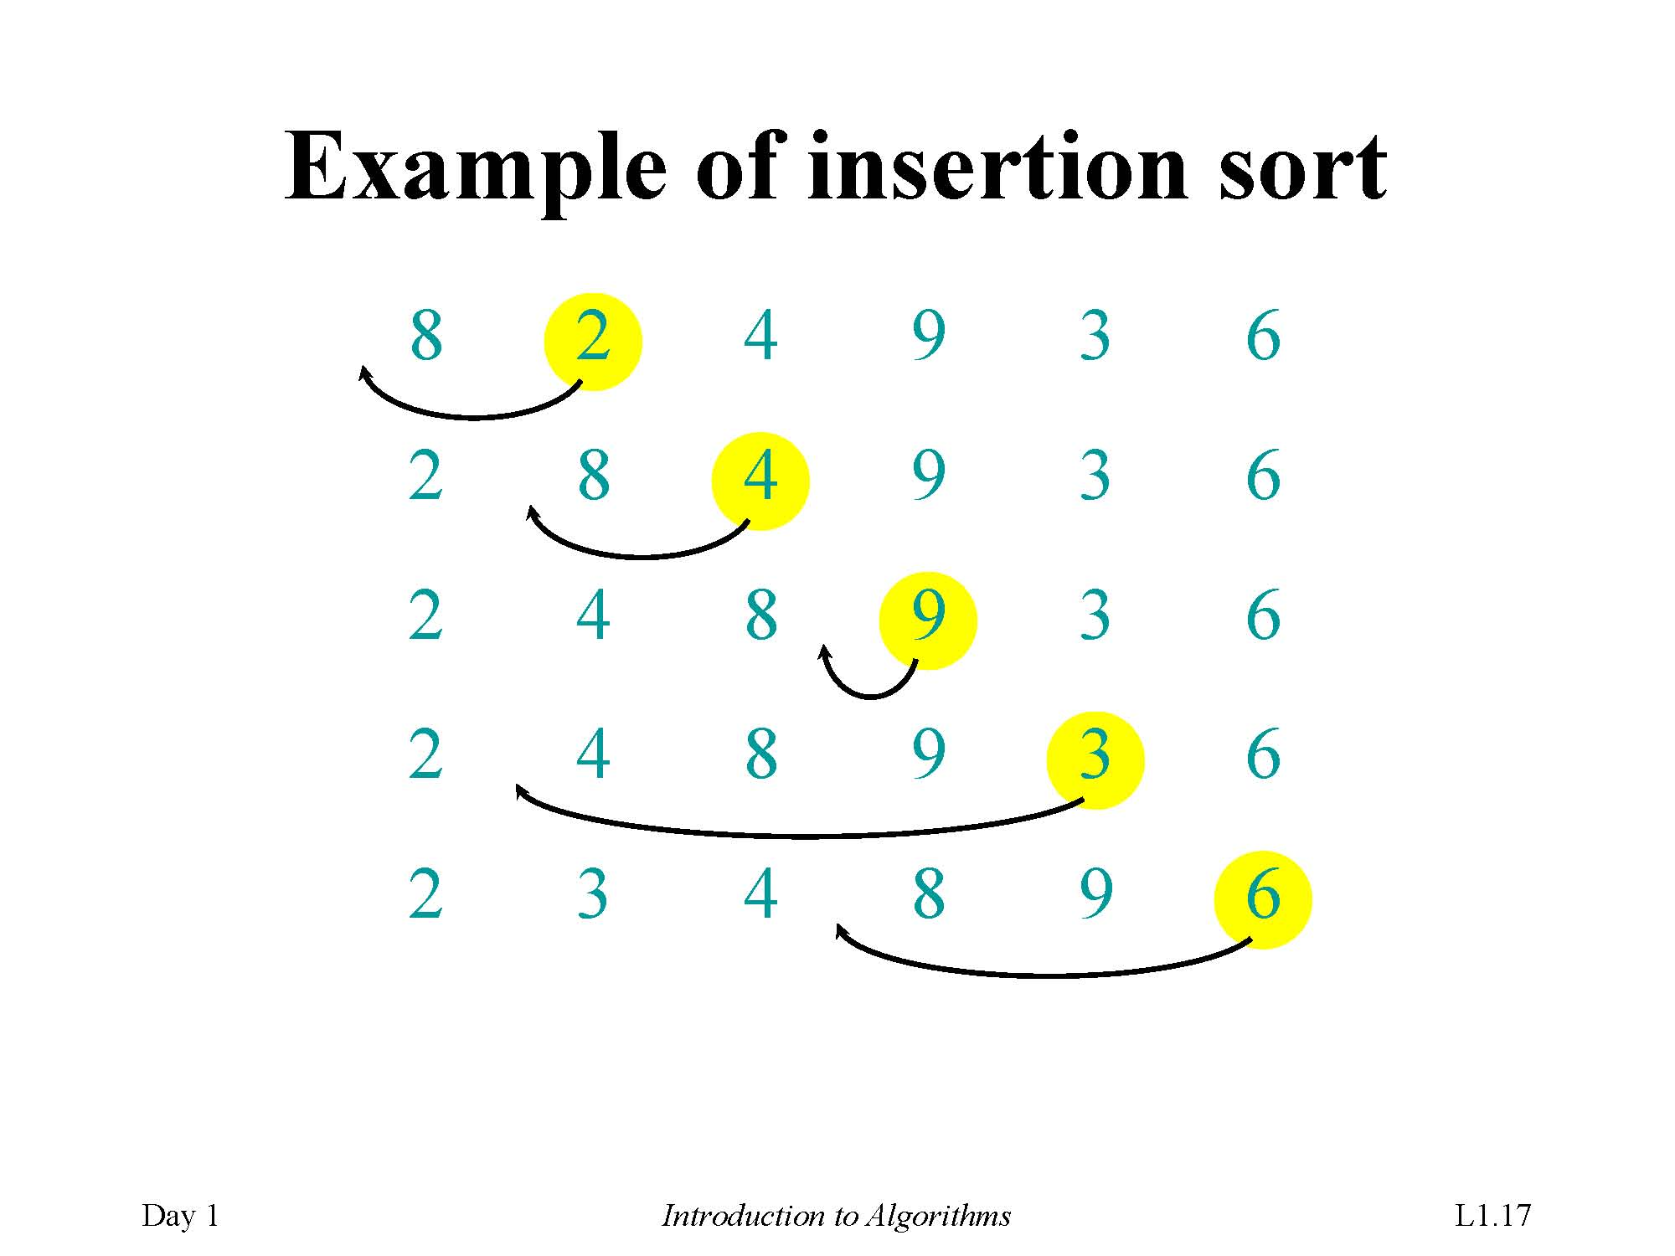
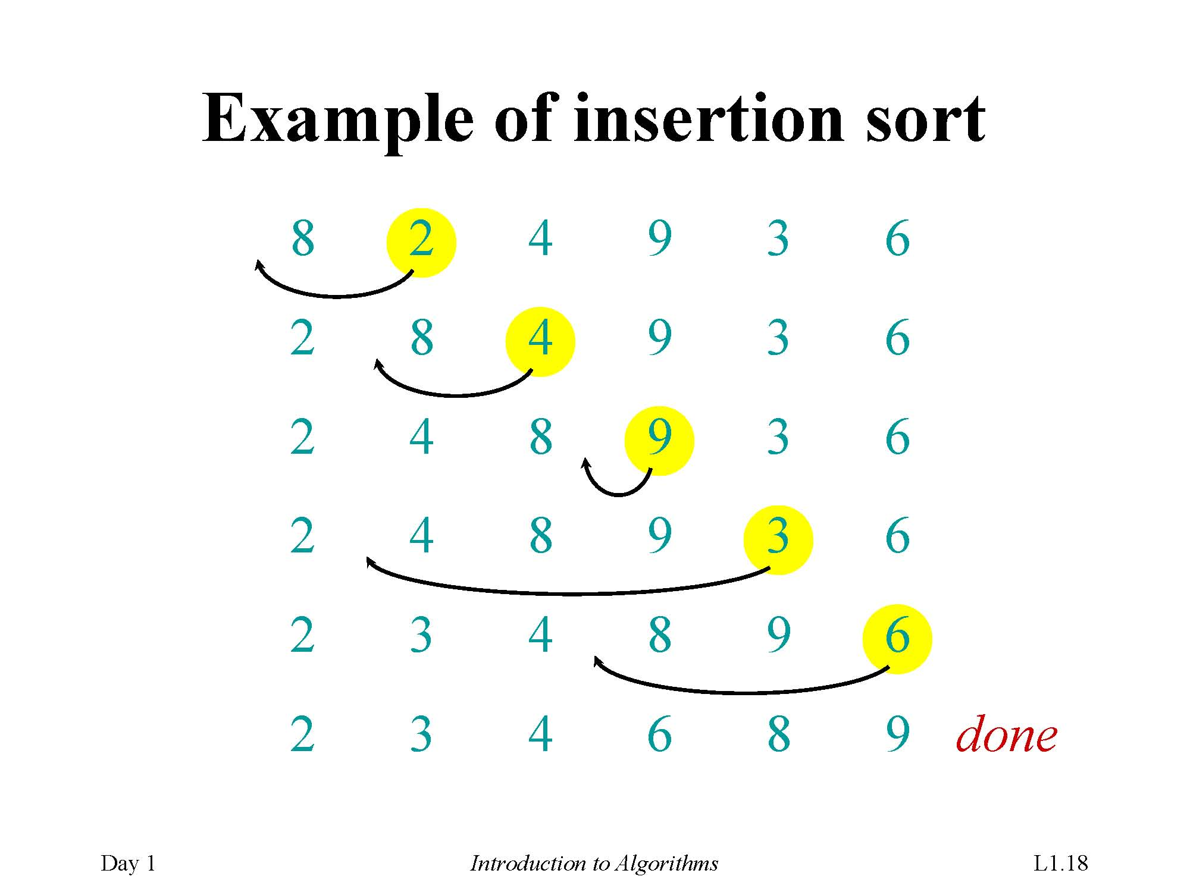
Example of insertion sort

Slide 22
Loop Invariant for Insertion sort
Initialization: Just before the first iteration, j = 2. The subarray A[1 . . j − 1] is the single element A[1], which is the element originally in A[1], and it is trivially sorted.
Maintenance: To be precise, we would need to state and prove a loop invariant for the inner while loop. Rather than getting bogged down in another loop invariant, we instead note that the body of the inner while loop works by moving A[ j − 1], A[ j − 2], A[ j − 3], and so on, by one position to the right until the proper position for key (which has the value that started out in A[ j ]) is found. At that point, the value of key is placed into this position.
Termination: The outer for loop ends when j > n; this occurs when j = n + 1. Therefore, j −1 = n. Plugging n in for j −1 in the loop invariant, the subarray A[1 . . n] consists of the elements originally in A[1 . . n] but in sorted order. In other words, the entire array is sorted!

Slide 23
2.2 Analyzing Algorithms
Run time: depend on the follow factors
Input: What kind of input?
Size of input: How many datum?
Machine: CPU How fast is the machine?
Computing model: RAM (random-access machine): How many machines?
In the RAM model, instructions are executed one after another, with no concurrent operations.
Operations| instructions contained in RAM model
Guarantee : Generally, we seek upper bounds on the running time, because everybody likes a guarantee
What is worst case?一般而言最坏时间复杂度与平均时间复杂度同阶

Slide 24
Time Complexity
Run time: machine-independent run time
t = sum{n1/v1+…+nk/vk}
t = sum{n1+…+nk}/v Suppose that vi=v (invariant)
t =c⋅sum{n1+…+nk}
t ∼ sum{n1+…+nk} machine-independent
Ignore machine-dependent constants
Time Complexity: simplified run time
T= sum{n1+…+nk} total number of basic operations
Notations:
T(n,I) | T_{A}(n,I) ← T(A;n,I) ← T= sum{n1+…+nk}

Slide 25
Time Complexity: Further Simplified
T(n,I): may differ from I (Any input of size n)
Further simplified time complexity: Three cases below
Worst-case: (usually)
T(n) = maximum time of algorithm on any input of size n.
T(n)=max_{I} {T(n,I)}
Time Complexity (Default )
Average-case: (sometimes)
T(n) = expected time of algorithm over all inputs of size n.
Need assumption of statistical distribution of inputs.
?
Best-case: (bogus)
Cheat with a slow algorithm that works fast on some input.(Ex2.2-4)

Slide 26
Θ-notation（Theta）
Asymptotic Analysis:
Asymptotic analysis: Look at growth of T(n) as n →∞.
Math:
Θ(g(n)) = { f (n): there exist positive constants c₁, c₂, and n₀ such that
0 ≤c₁ g(n) ≤ f (n) ≤ c₂ g(n) for all n ≥ n₀}
Engineering:
Drop low-order terms; ignore leading constants.
Example: 3n³ + 90n² –5n + 6046 = Θ(n³)

Slide 27
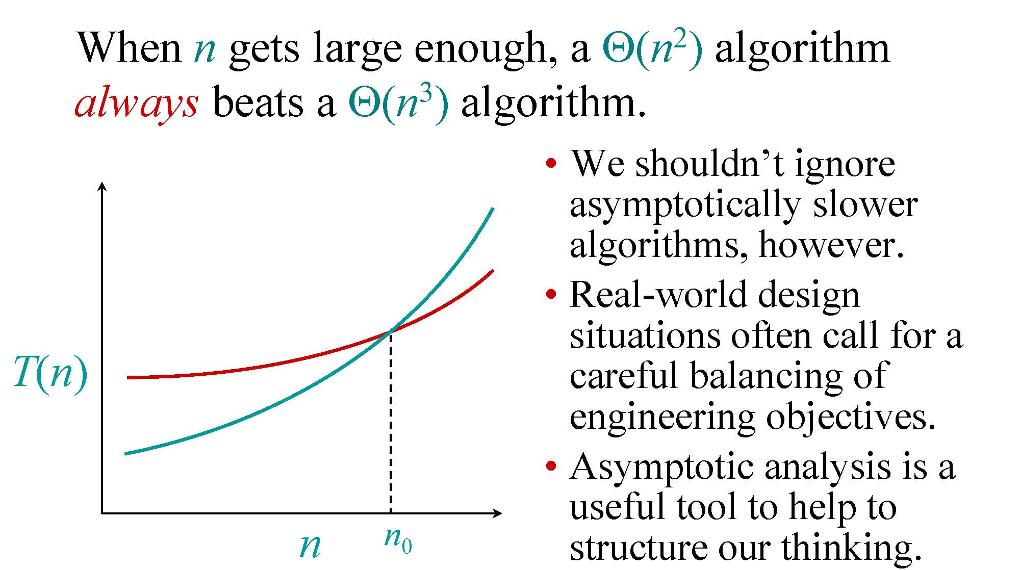
Asymptotic performance
When n gets large enough, a Θ(n2) algorithm always beats a Θ(n3) algorithm.
We shouldn’t ignoreasymptotically sloweralgorithms, however.
Real-world designsituations often call for a careful balancing ofengineering objectives.
Asymptotic analysis is a useful tool to help to nn0 structure our thinking.

Slide 28
Analyzing algorithm: Insertion Sort
Worst case: Input reverse sorted.
T(n)= sum {j-1, j=2..n} = n(n-1)/2 = Θ(n²) number of move operations
T(n)= sum_{j=2..n}{Θ(j)} = Θ(n²)
How to calculate T(n)?
Average-case & Best-case
?

Slide 29
Analyzing algorithm: Insertion Sort
• Assume that the i th line takes time ci , which is a constant. (Since the third line is a comment, it takes no time.)
For j = 2, 3, . . . , n, let tj be the number of times that the while loop test is executed for that value of j .
Note that when a for or while loop exits in the usual way.due to the test in the loop header,the test is executed one time more than the loop body.

Slide 30
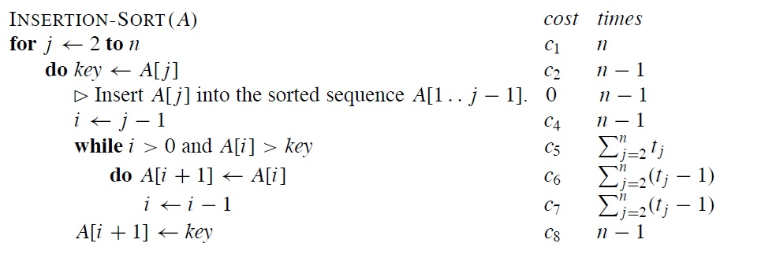
Analyzing algorithm: Insertion Sort

Slide 31
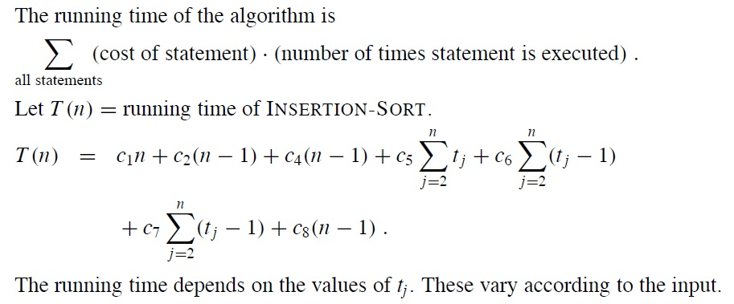
Analyzing algorithm: Insertion Sort

Slide 32
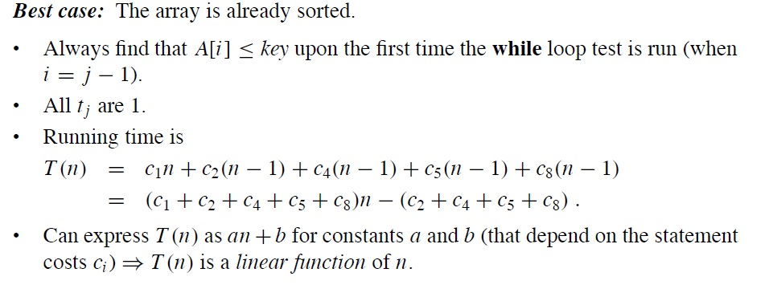
Analyzing algorithm: Insertion Sort

Slide 33
Worst case of insertion sort
Worst case: The array is in reverse sorted order.
Always find that A[i ] > key in while loop test.
Have to compare key with all elements to the left of the j th position⇒compare with j − 1 elements.
Since the while loop exits because i reaches 0, there.s one additional test after the j − 1 tests ⇒tj = j .

Slide 34
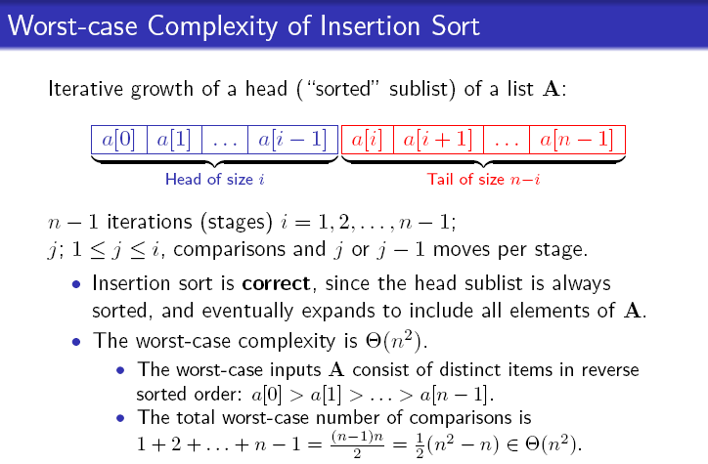

Slide 35
Average case of insertion sort
On average, the key in A[ j ] is less than half the elements in A[1 . . j − 1] and it’s greater than the other half. On average, the while loop has to look halfway through the sorted subarray A[1 . . j − 1] to decide where to drop key.
⇒t j = j/2.

Slide 36
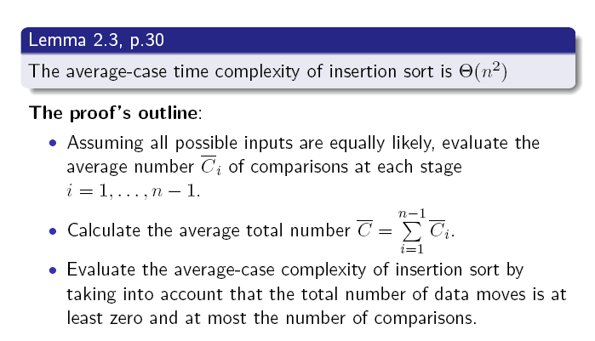

Slide 37
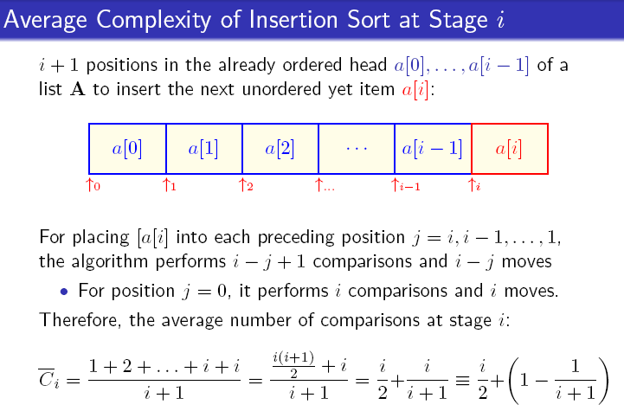

Slide 38
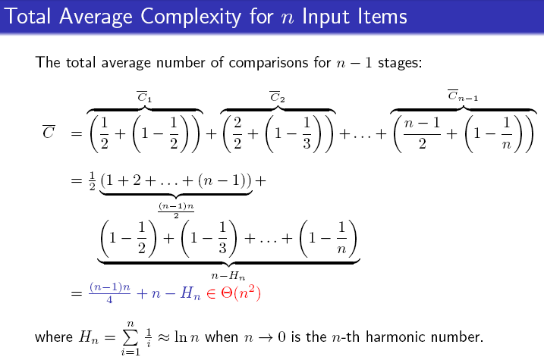

Slide 39
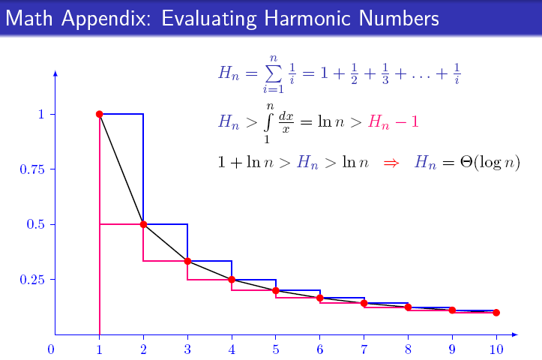

Slide 40
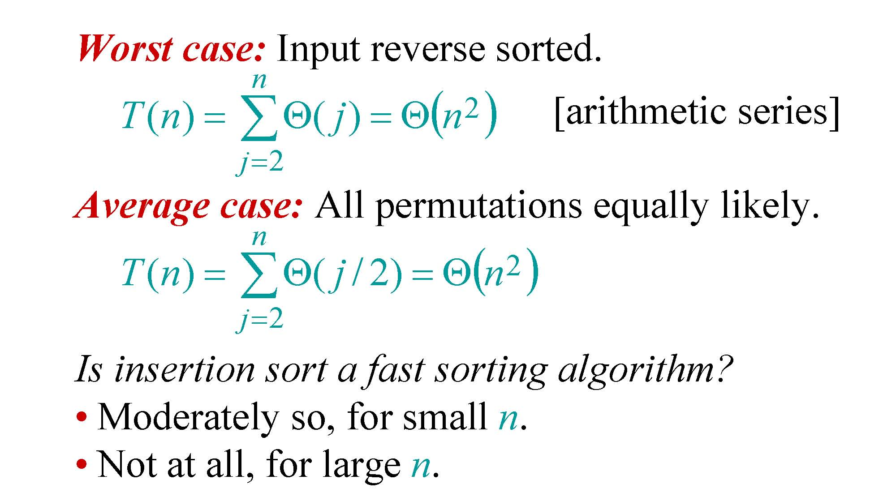
Insertion sort analysis
Worst case: Input reverse sorted.
n
2
() [arithmetic series]
T (n) =∑Θ( j) =Θn j=2
Average case: All permutations equally likely.
n
2
T (n) =∑Θ( j / 2) =Θ(n ) j=2
Is insertion sort a fast sorting algorithm?
Moderately so, for small n.
Not at all, for large n.

Slide 41
Insertion sort analysis
Order of growth
Another abstraction to ease analysis and focus on the important features.
Look only at the leading term of the formula for running time.
Drop lower-order terms.
Ignore the constant coefÞcient in the leading term.

Slide 42
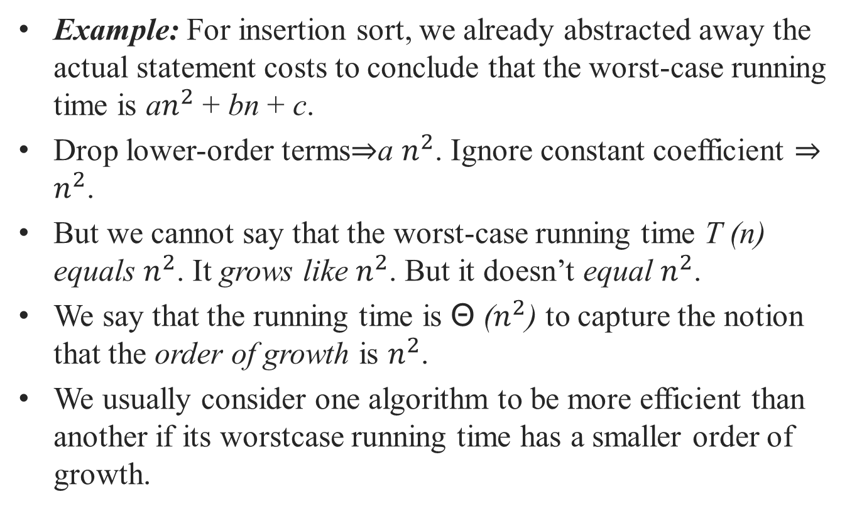
Insertion sort analysis
Example: For insertion sort, we already abstracted away the actual statement costs to conclude that the worst-case running time is a$n^{2}$ + bn + c.
Drop lower-order terms⇒a $n^{2}$. Ignore constant coefficient ⇒ $n^{2}$.
But we cannot say that the worst-case running time T (n) equals $n^{2}$. It grows like $n^{2}$. But it doesn’t equal $n^{2}$.
We say that the running time is Θ ($n^{2}$) to capture the notion that the order of growth is $n^{2}$.
We usually consider one algorithm to be more efficient than another if its worstcase running time has a smaller order of growth.

Slide 43
2.3 Designing Algorithms
Designing Algorithms: How?
Divide-and-Conquer Approach
Merge Sort
Time complexity for Divide-and-Conquer

Slide 44
Divide-and-Conquer Approach
Divide-and-conquer paradigm
Divide the problem into a number of subproblems.
Conquer the subproblems by solving them recursively. If the subproblem sizes are small enough, however, just solve the subproblems in a straightforward manner.
Combine the solutions to the subproblems into the solution for the original problem.

Slide 45
Merge Sort Algorithm: DC
Problem:
Input: A[1,n]
Output: A[1,n] in sorted order
Divide-and-conquer paradigm
Divide: Divide the n-element sequence to be sorted into two subsequences of n/2 elements each.
Conquer: Sort the two subsequences recursively using merge sort.
Combine: Merge the two sorted subsequences to produce the sorted answer.

Slide 46
Merge Sort Algorithm: Pseudocode
MERGE-SORT A[1 . . n]
1. If n = 1, done.
2. Recursively sort A[ 1 . . ⎡n/2⎤ ]
and A[⎡n/2⎤+1 . . n ] .
3. “Merge” the 2 sorted lists.
… to be continued!
Key subroutine: MERGE

Slide 47
Merge Sort Algorithm

Slide 48
Merge Sort Algorithm: General Case
Problem:
Input: A[p,r]
Output: A[p,r] in sorted order
MERGE-SORT(A, p, r)
if p < r check the base case
then q ← ⌊(p + r)/2⌋ divide
MERGE-SORT(A, p, q) conquer
MERGE-SORT(A, q + 1, r) conquer
MERGE(A, p, q, r) combine

Slide 49
Merge Two Sorted Lists
Problem:
Input: A[p,q] and A[q+1,r], p ≤ q< r, are in sorted order
Output: A[p,r] in sorted order
Procedure
See the Instance below

Slide 50
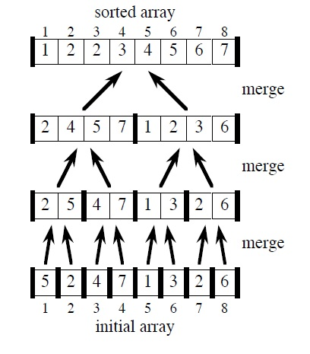

Slide 51
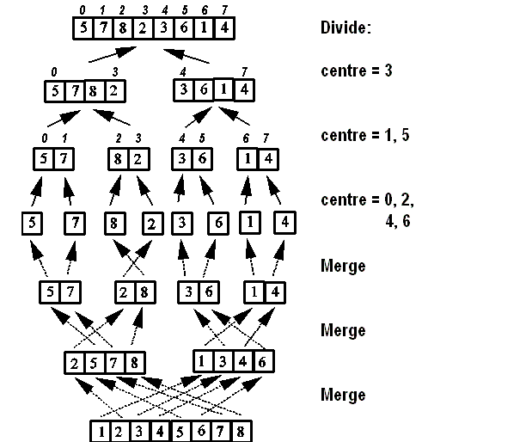

Slide 52
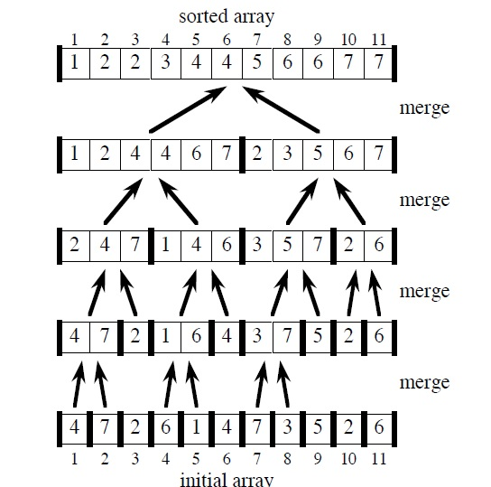

Slide 53
Merge Two Sorted Lists : Pseudocode
停止条件
输出排序完成序列起止位置
最后一次跳出循环，要么是L[i]为正无穷，要么是R[i]为正无穷

Slide 54
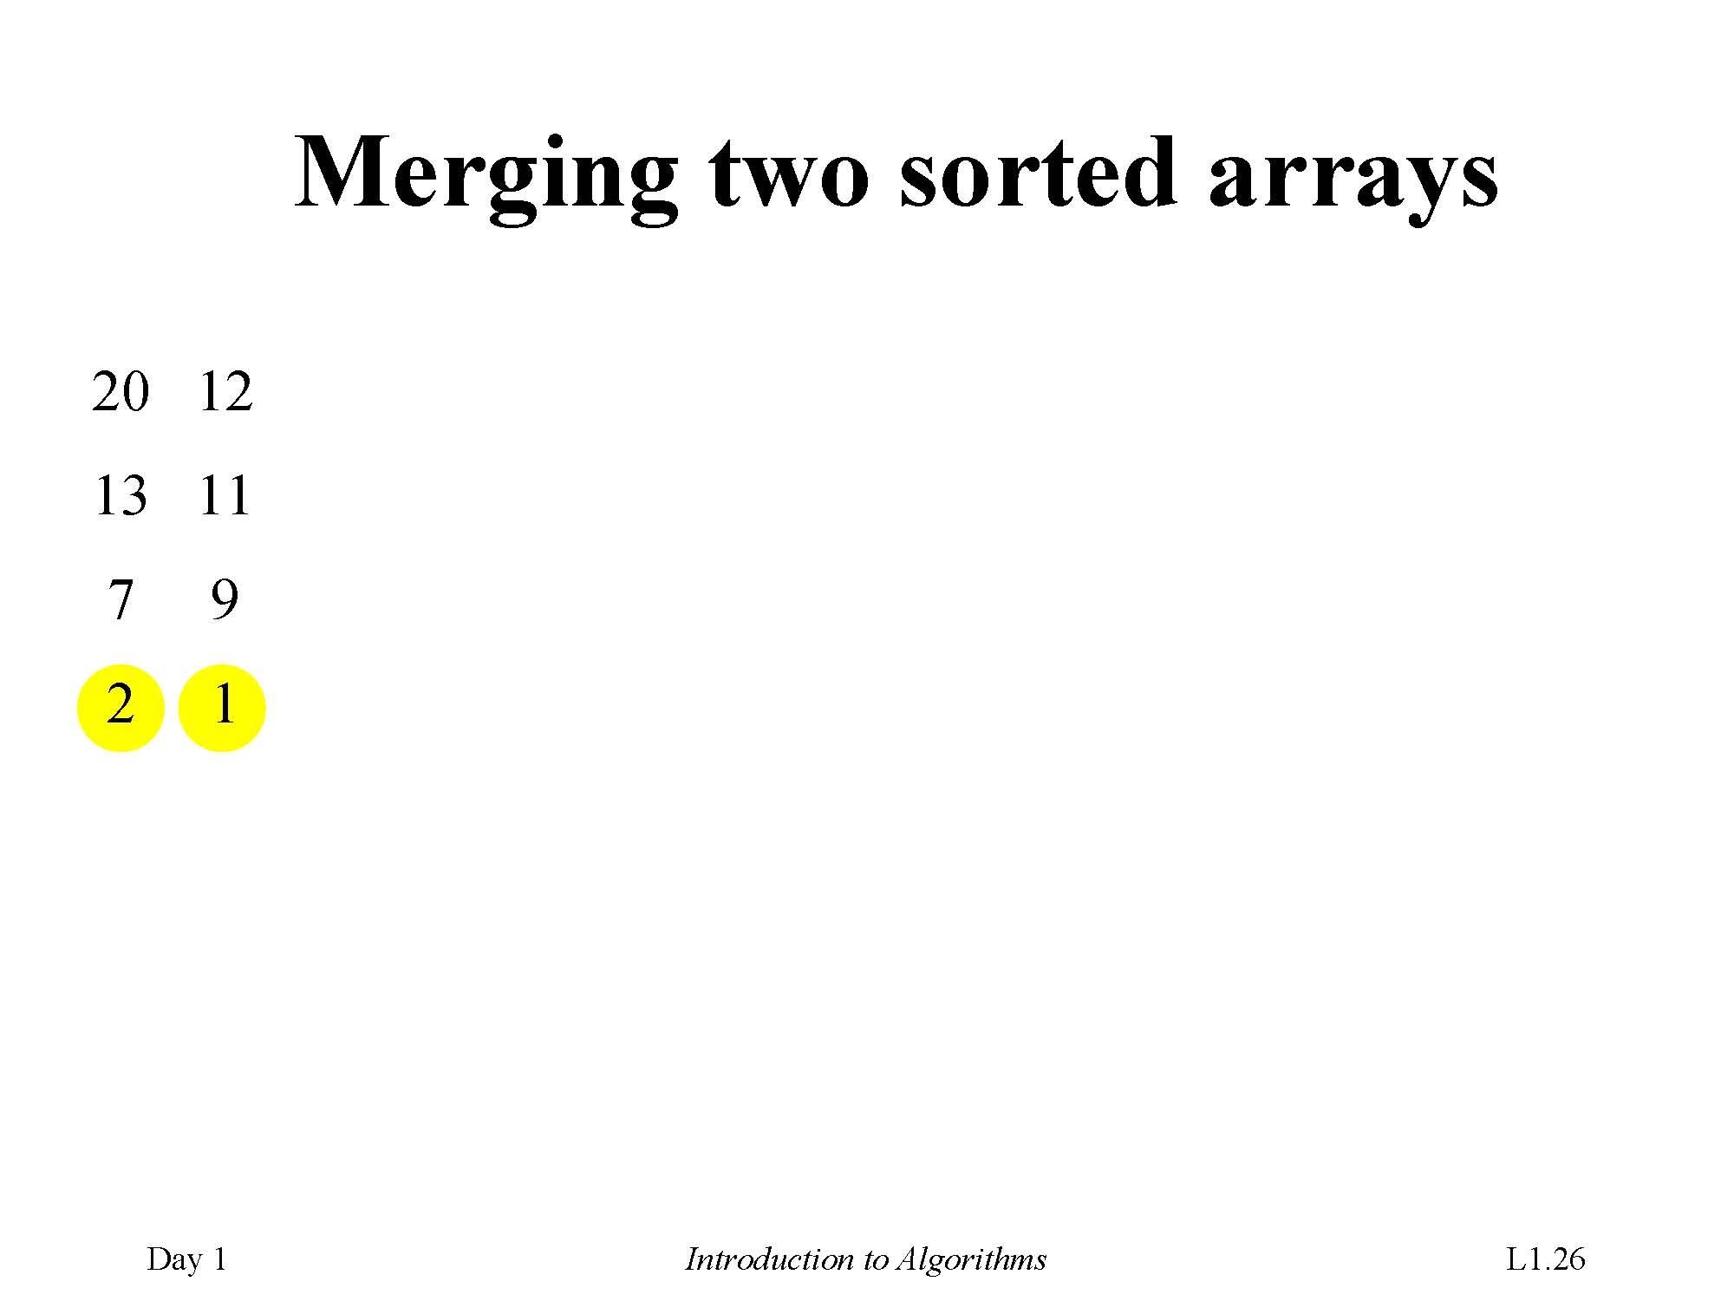
Merging two sorted arrays
2 7 13 20
1 9 11 12

Slide 55
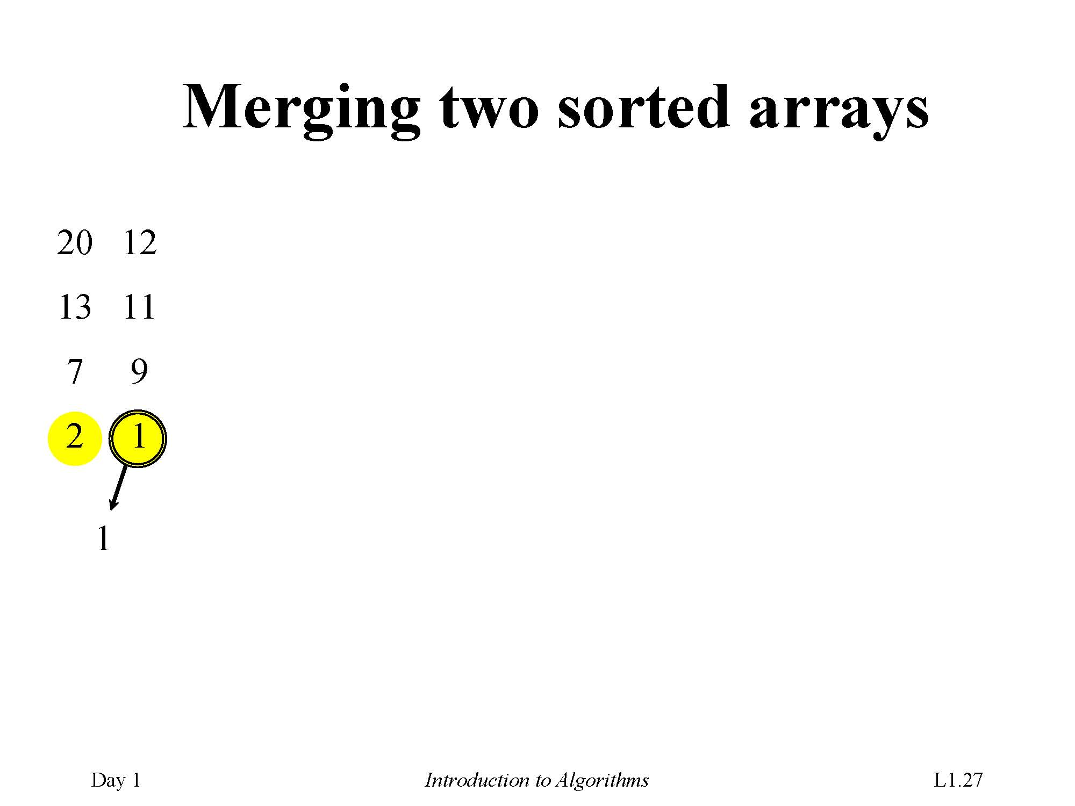

Slide 56
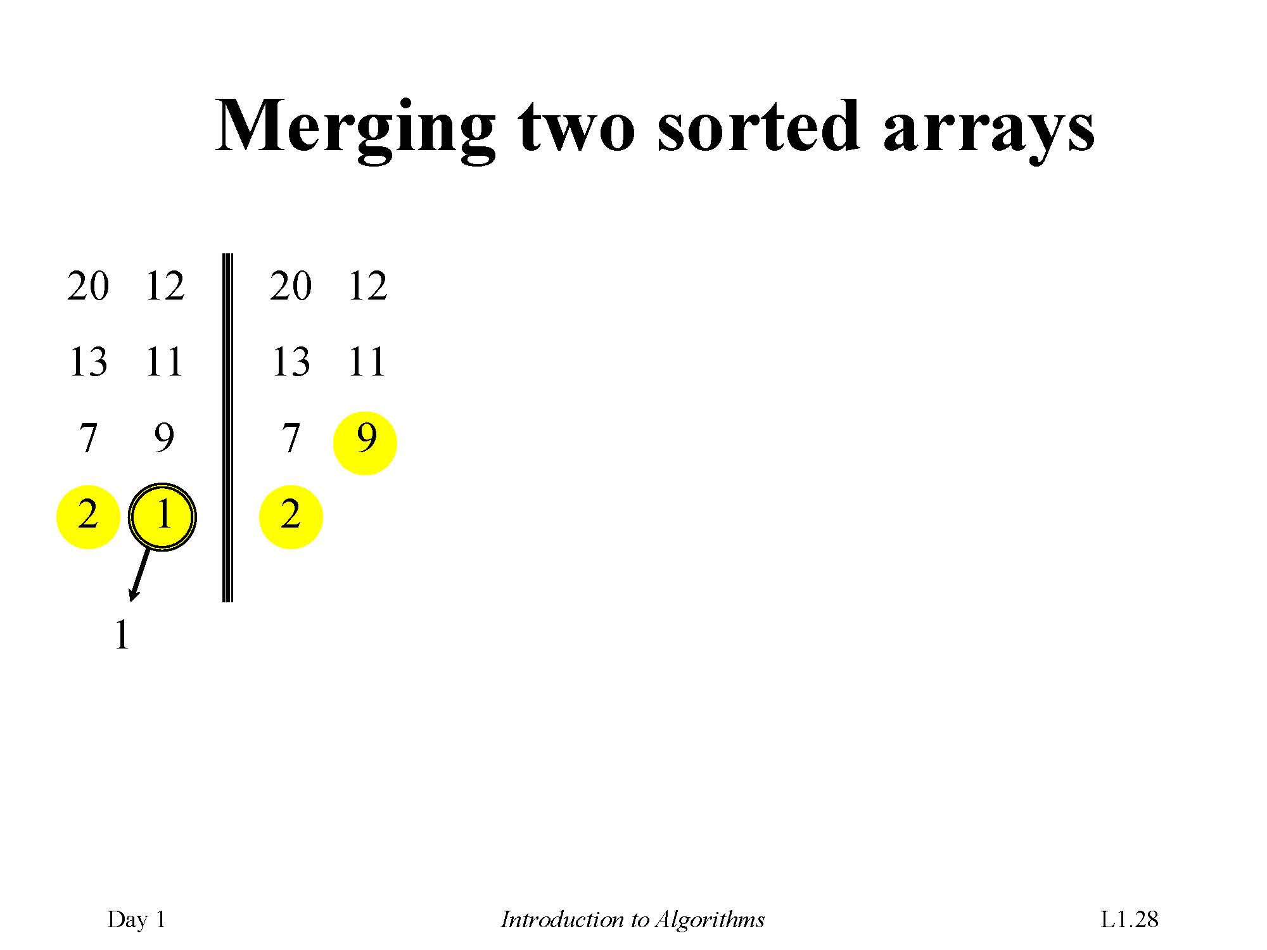

Slide 57
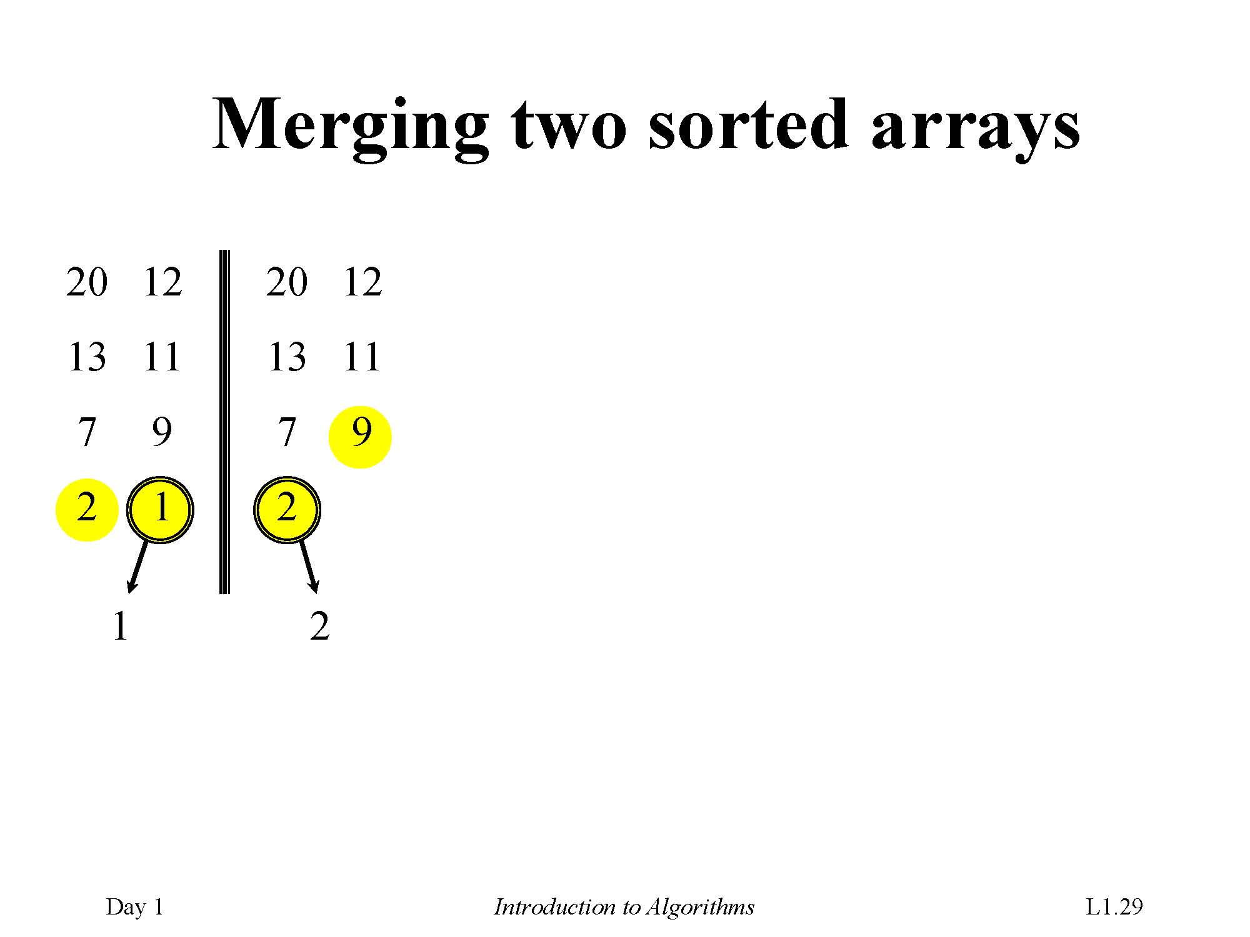

Slide 58
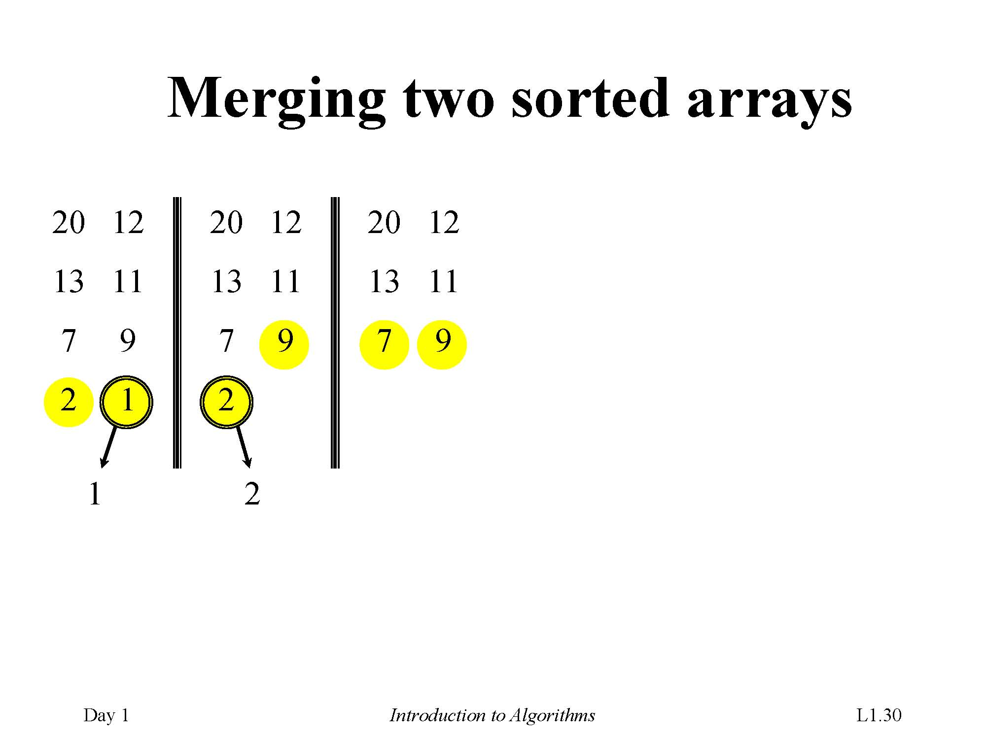

Slide 59
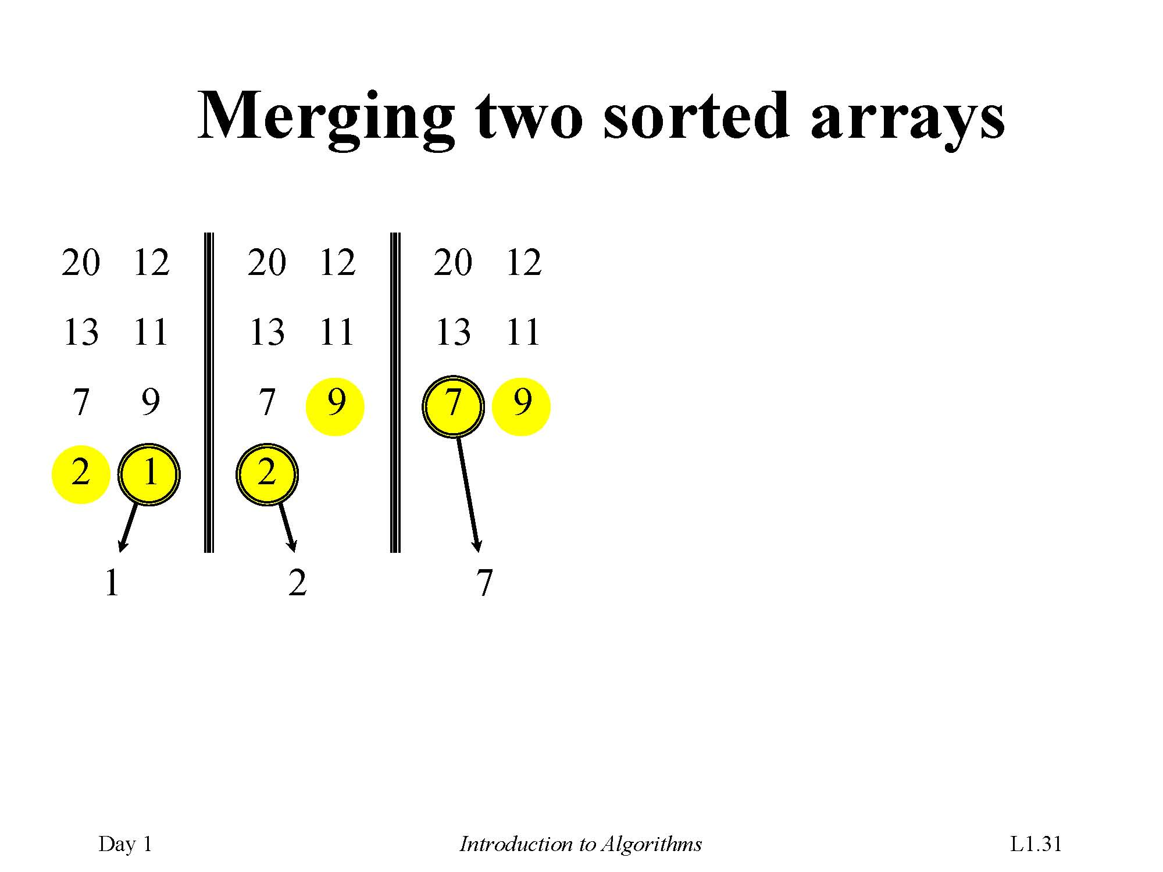

Slide 60
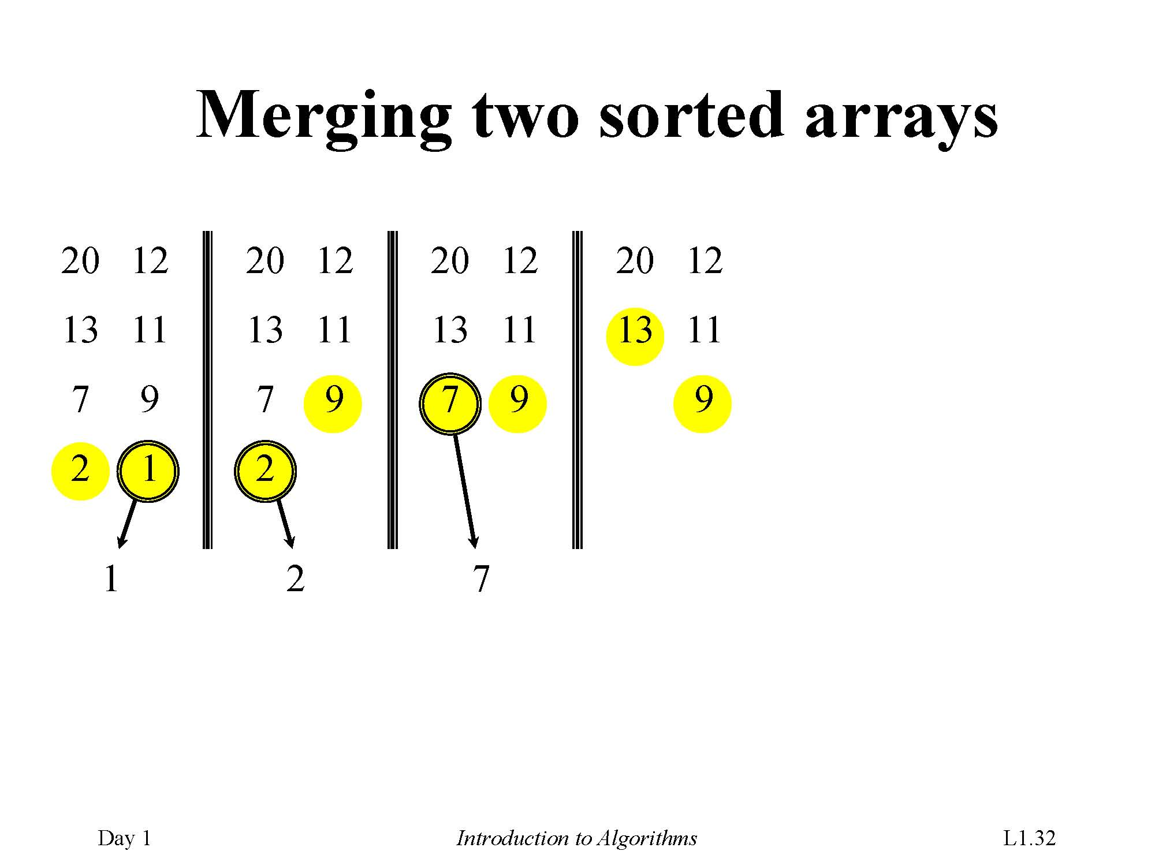

Slide 61
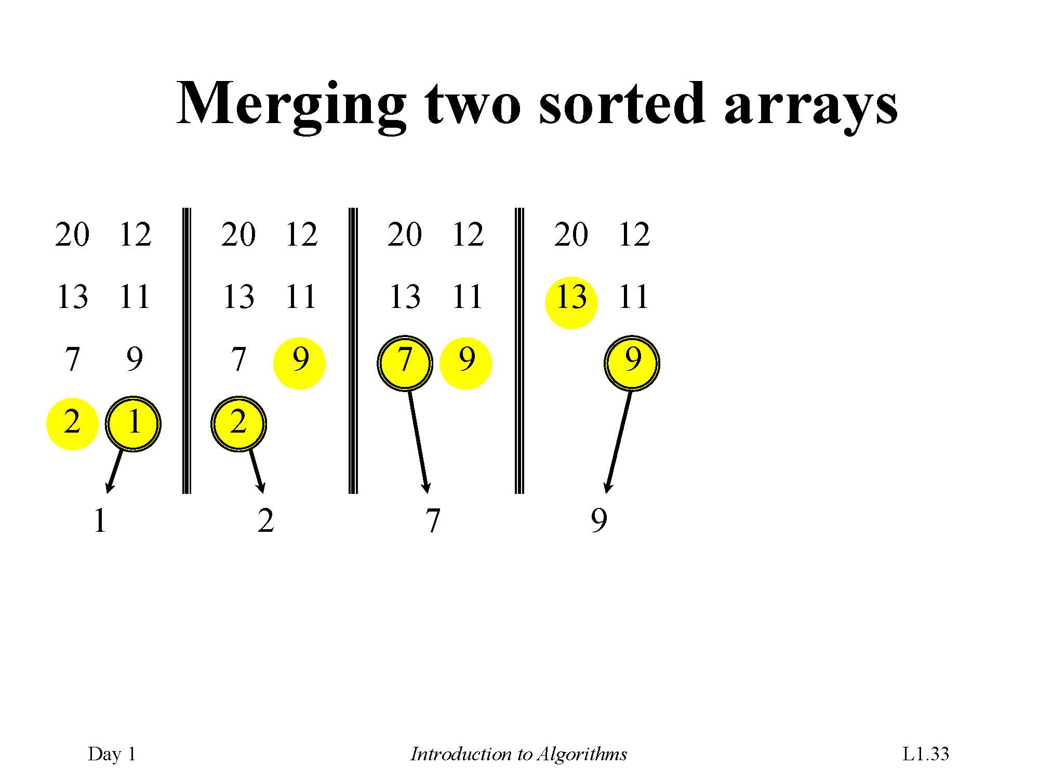

Slide 62
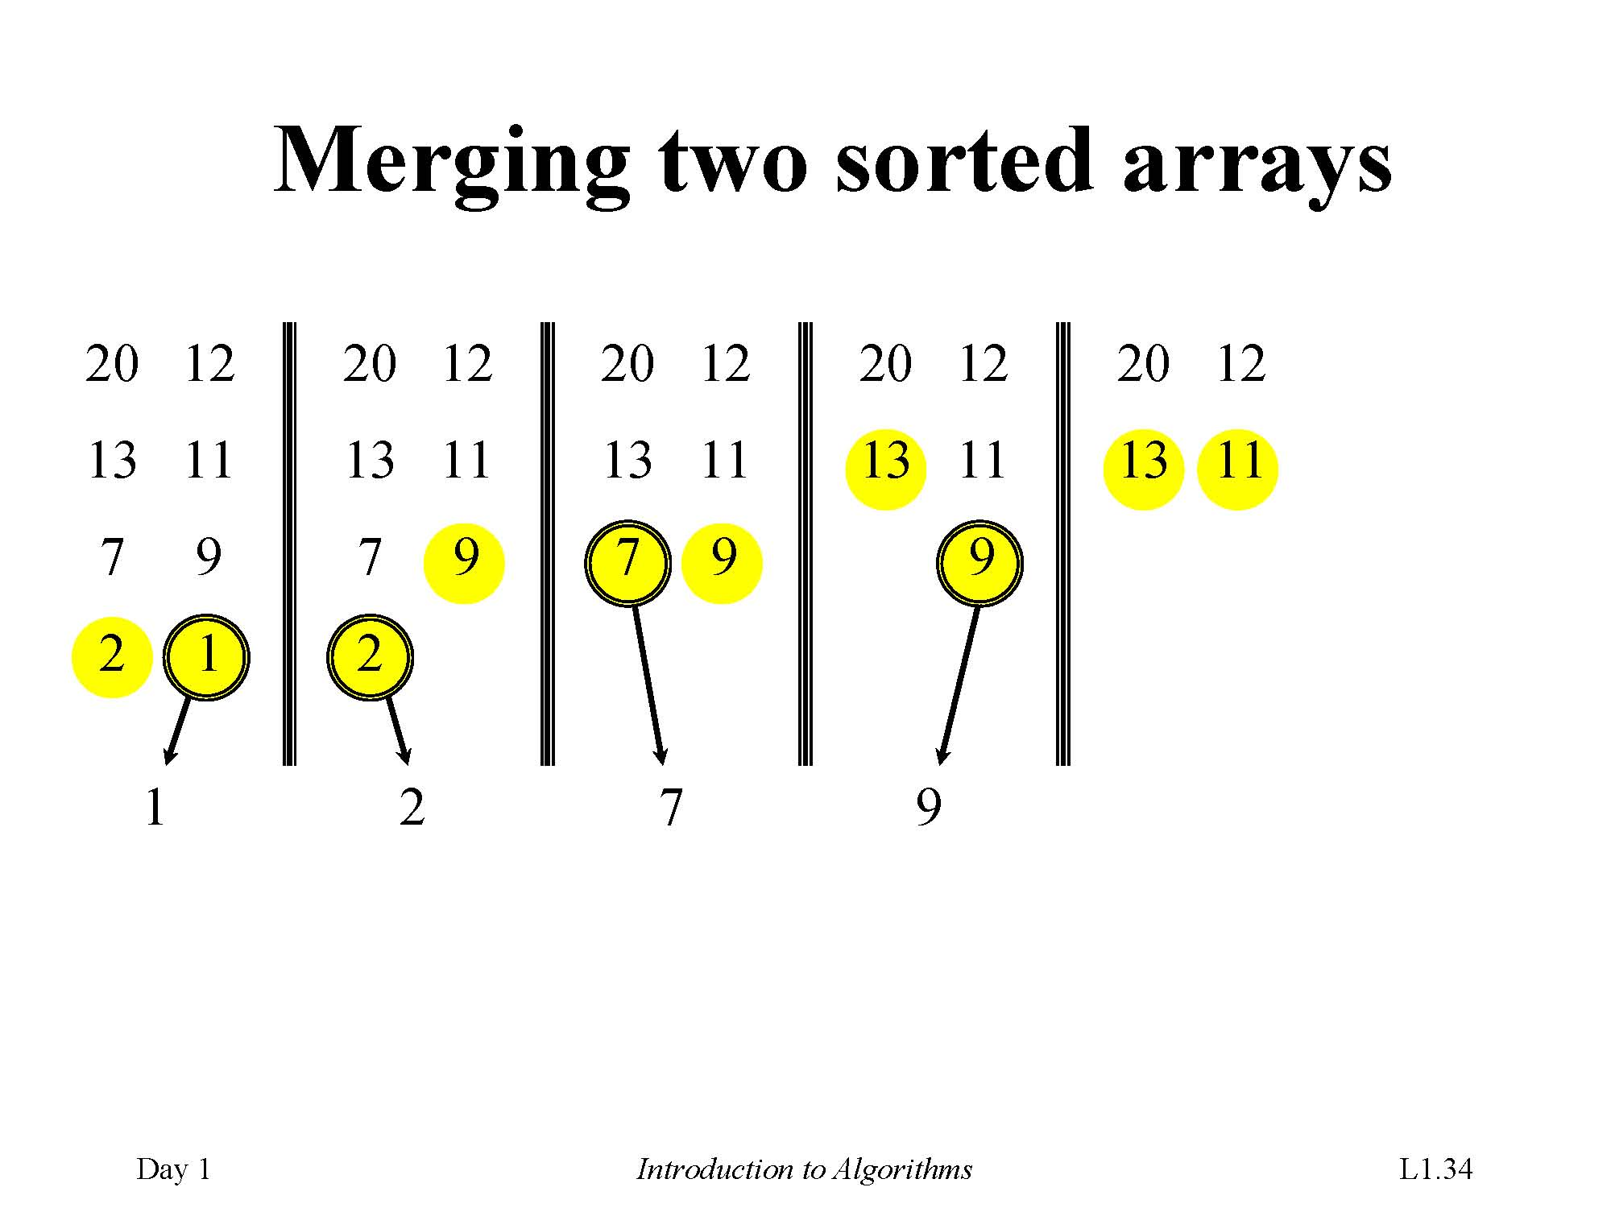

Slide 63
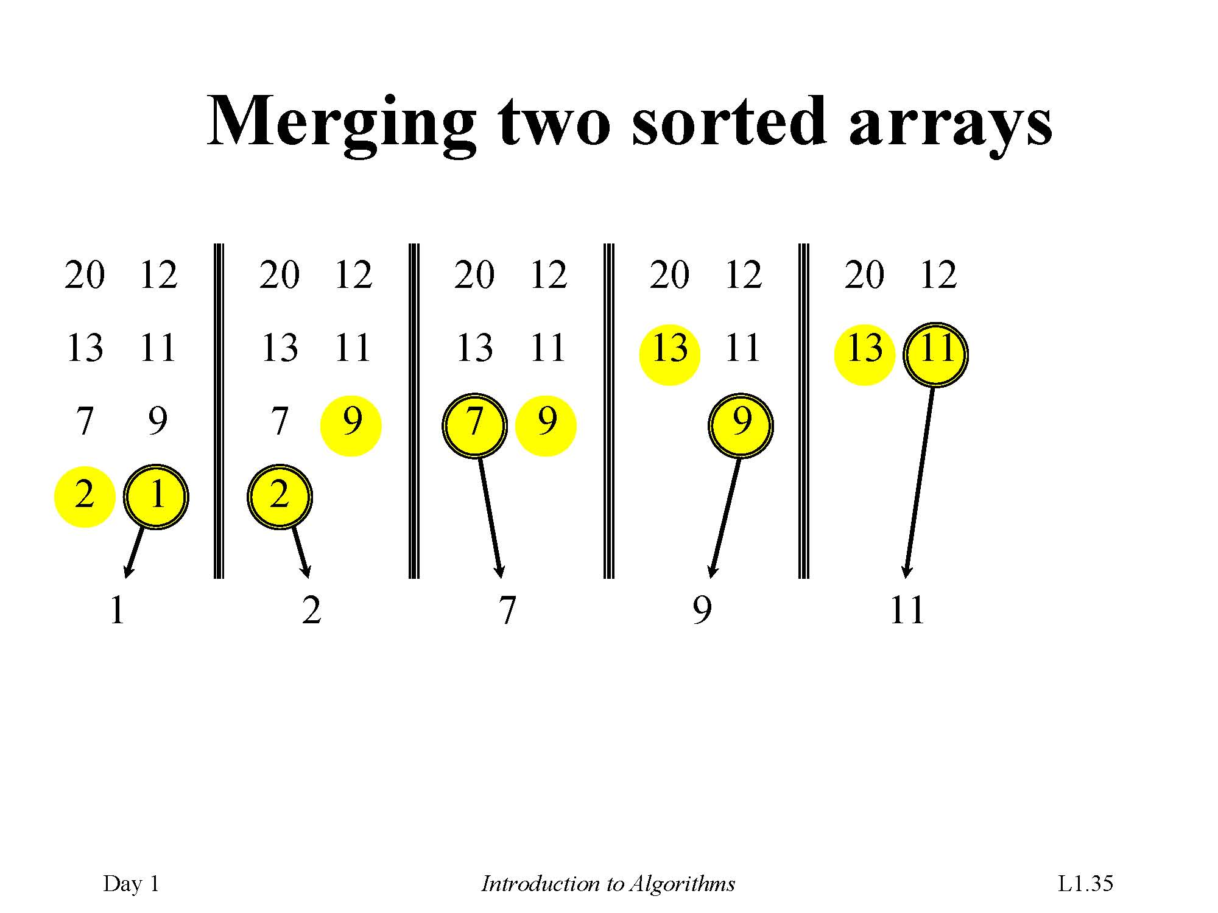

Slide 64
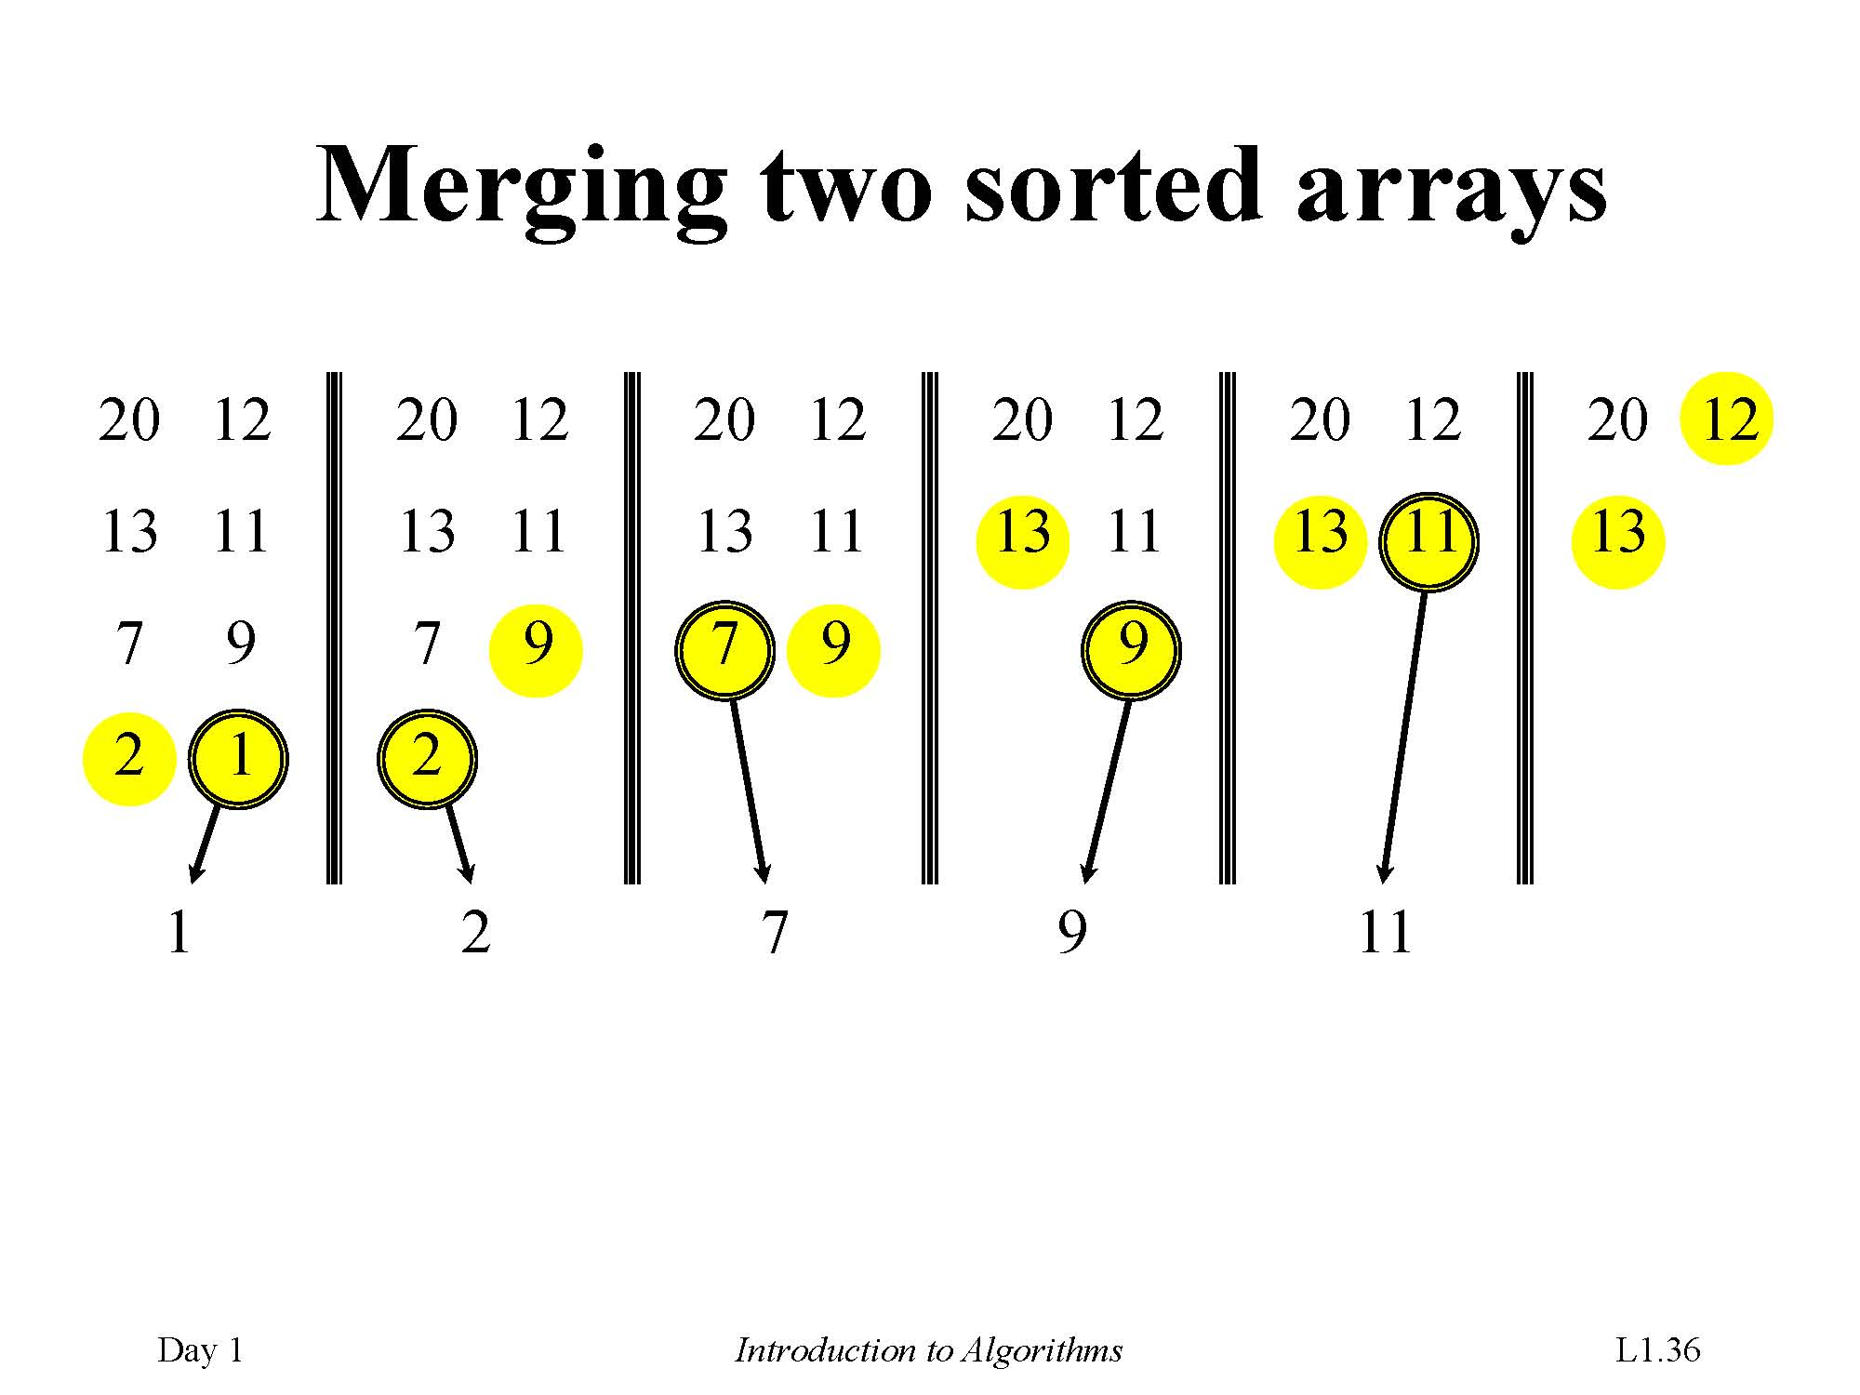

Slide 65
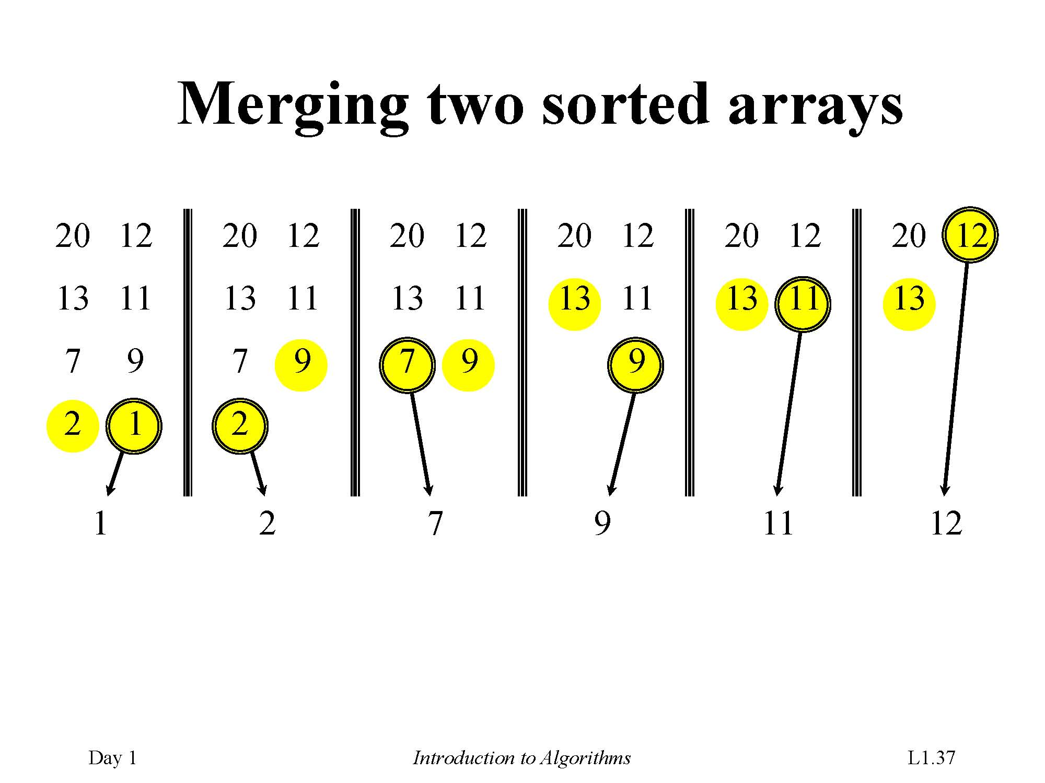

Slide 66
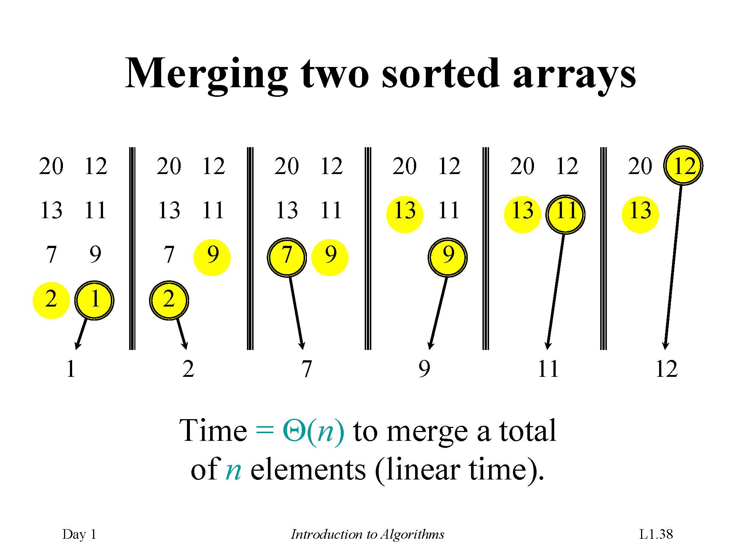

Slide 67
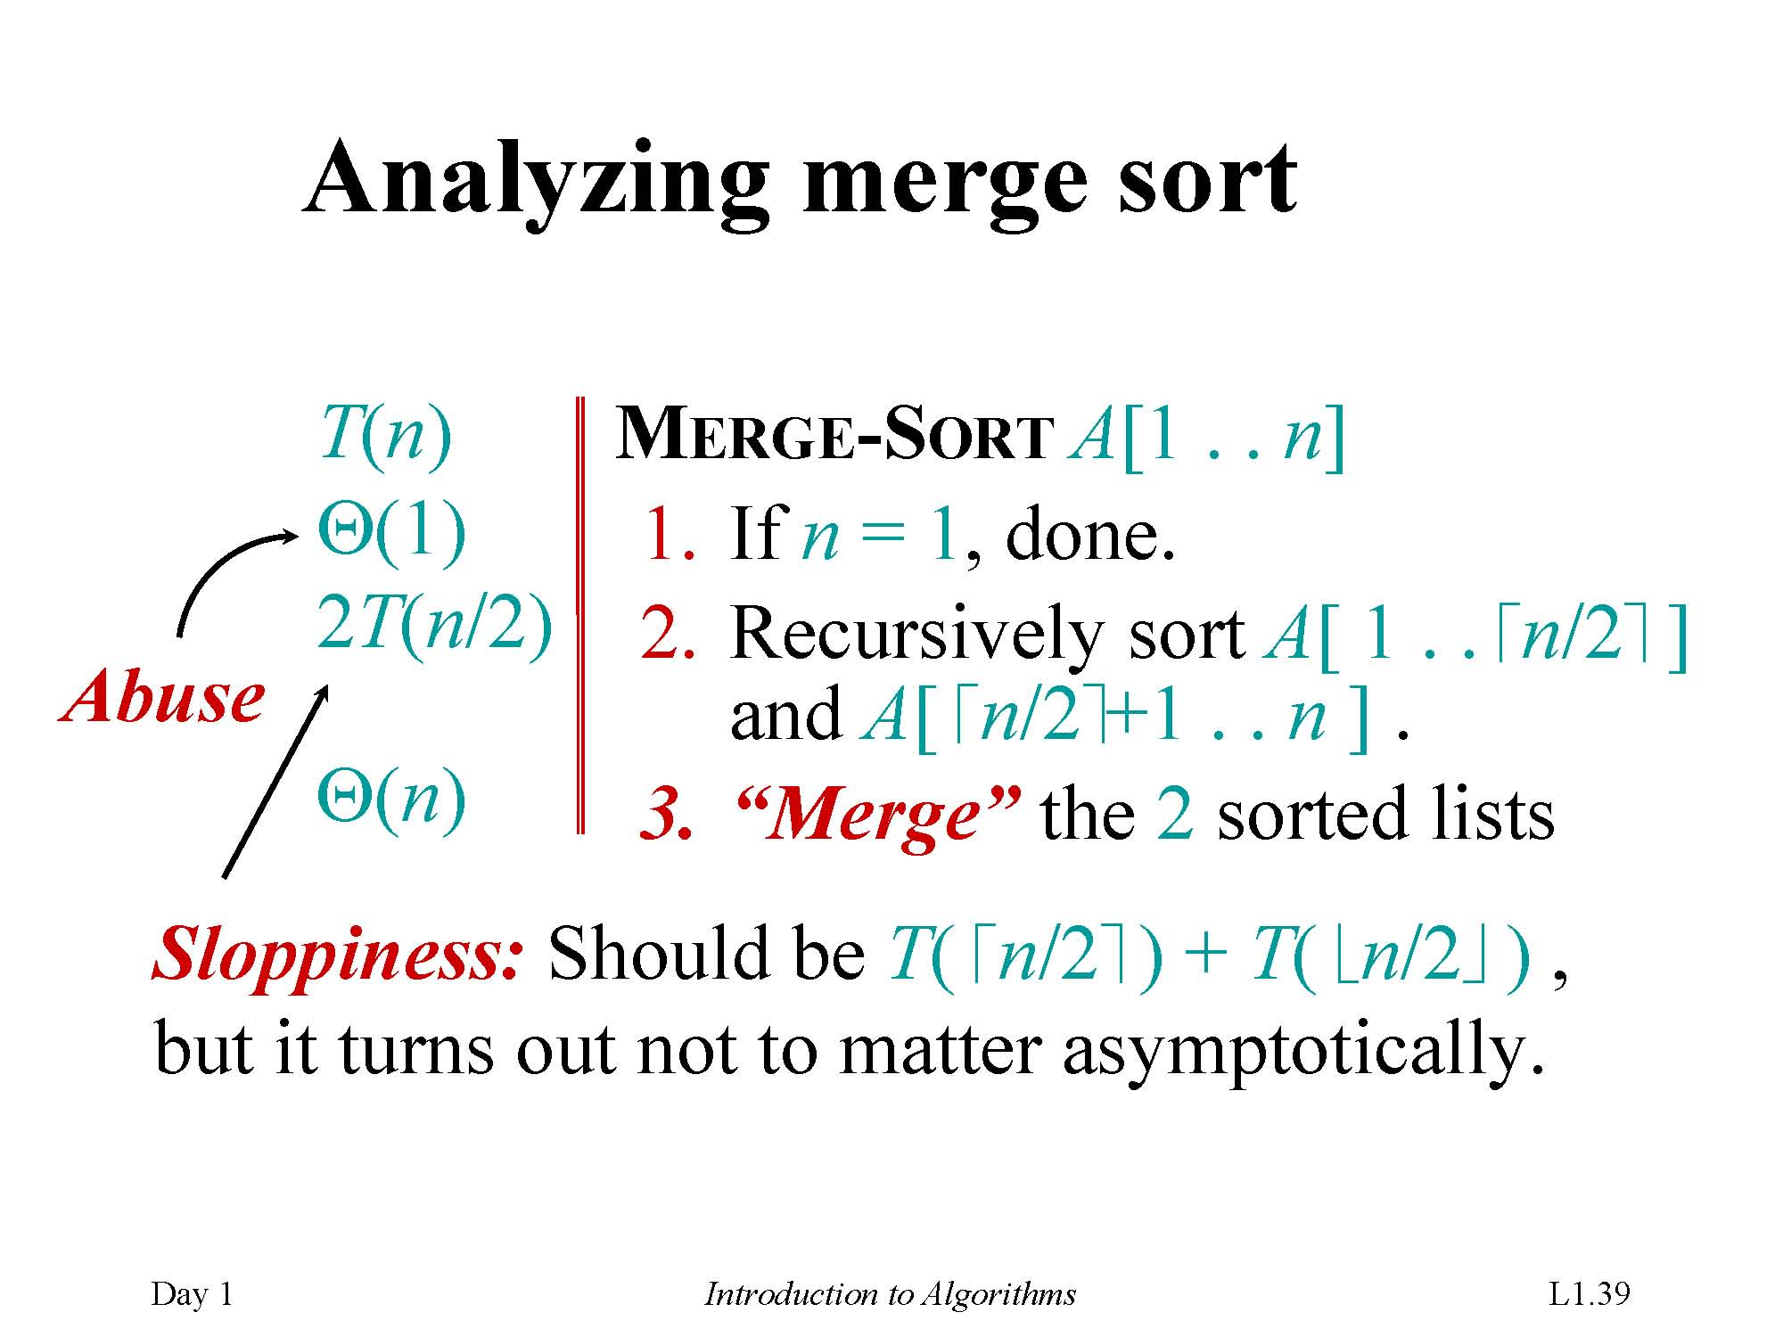

Slide 68
Recurrence
Use a recurrence equation (more commonly, a recurrence) to describe the running time of a divide-and-conquer algorithm.
Let T (n) = running time on a problem of size n.
If the problem size is small enough (say, n ≤ c for some constant c), we have a base case. The brute-force solution takes constant time: Θ(1).

Slide 69
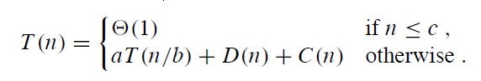
Recurrence
Otherwise, suppose that we divide into a subproblems, each 1/b the size of the original. (In merge sort, a = b = 2.)
Let the time to divide a size-n problem be D(n).
There are a subproblems to solve, each of size n/b ⇒ each subproblem takes T (n/b) time to solve ⇒we spend a*T (n/b) time solving subproblems.
Let the time to combine solutions be C(n).
We get the recurrence

Slide 70
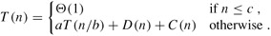
Time complexity for Divide-and-Conquer
Time complexity for Divide-and-Conquer
A recurrence
Divide-and-conquer paradigm
Divide the problem into a number of subproblems.
Conquer the subproblems by solving them recursively. If the subproblem sizes are small enough, however, just solve the subproblems in a straightforward manner.
Combine the solutions to the subproblems into the solution for the original problem.

Slide 71
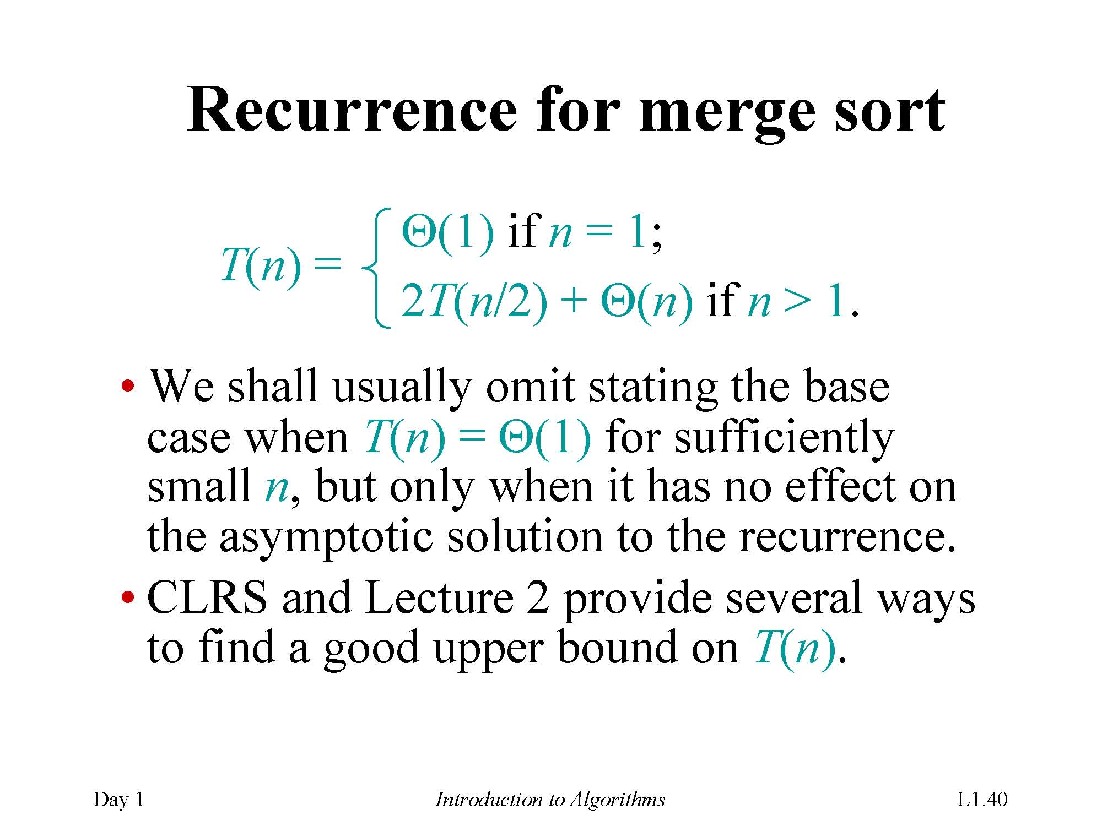

Slide 72
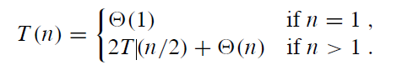
Recurrence for merge sort
Divide: Just compute q as the average of p and r ⇒ D(n) = (1).
Conquer: Recursively solve 2 subproblems, each of size n/2⇒2T (n/2).
Combine: MERGE on an n-element subarray takes (n) time ⇒C(n) = Θ(n).
Since D(n) = Θ (1) and C(n) = Θ(n), summed together they give a function that is linear in n: Θ(n)⇒recurrence for merge sort running time is

Slide 73
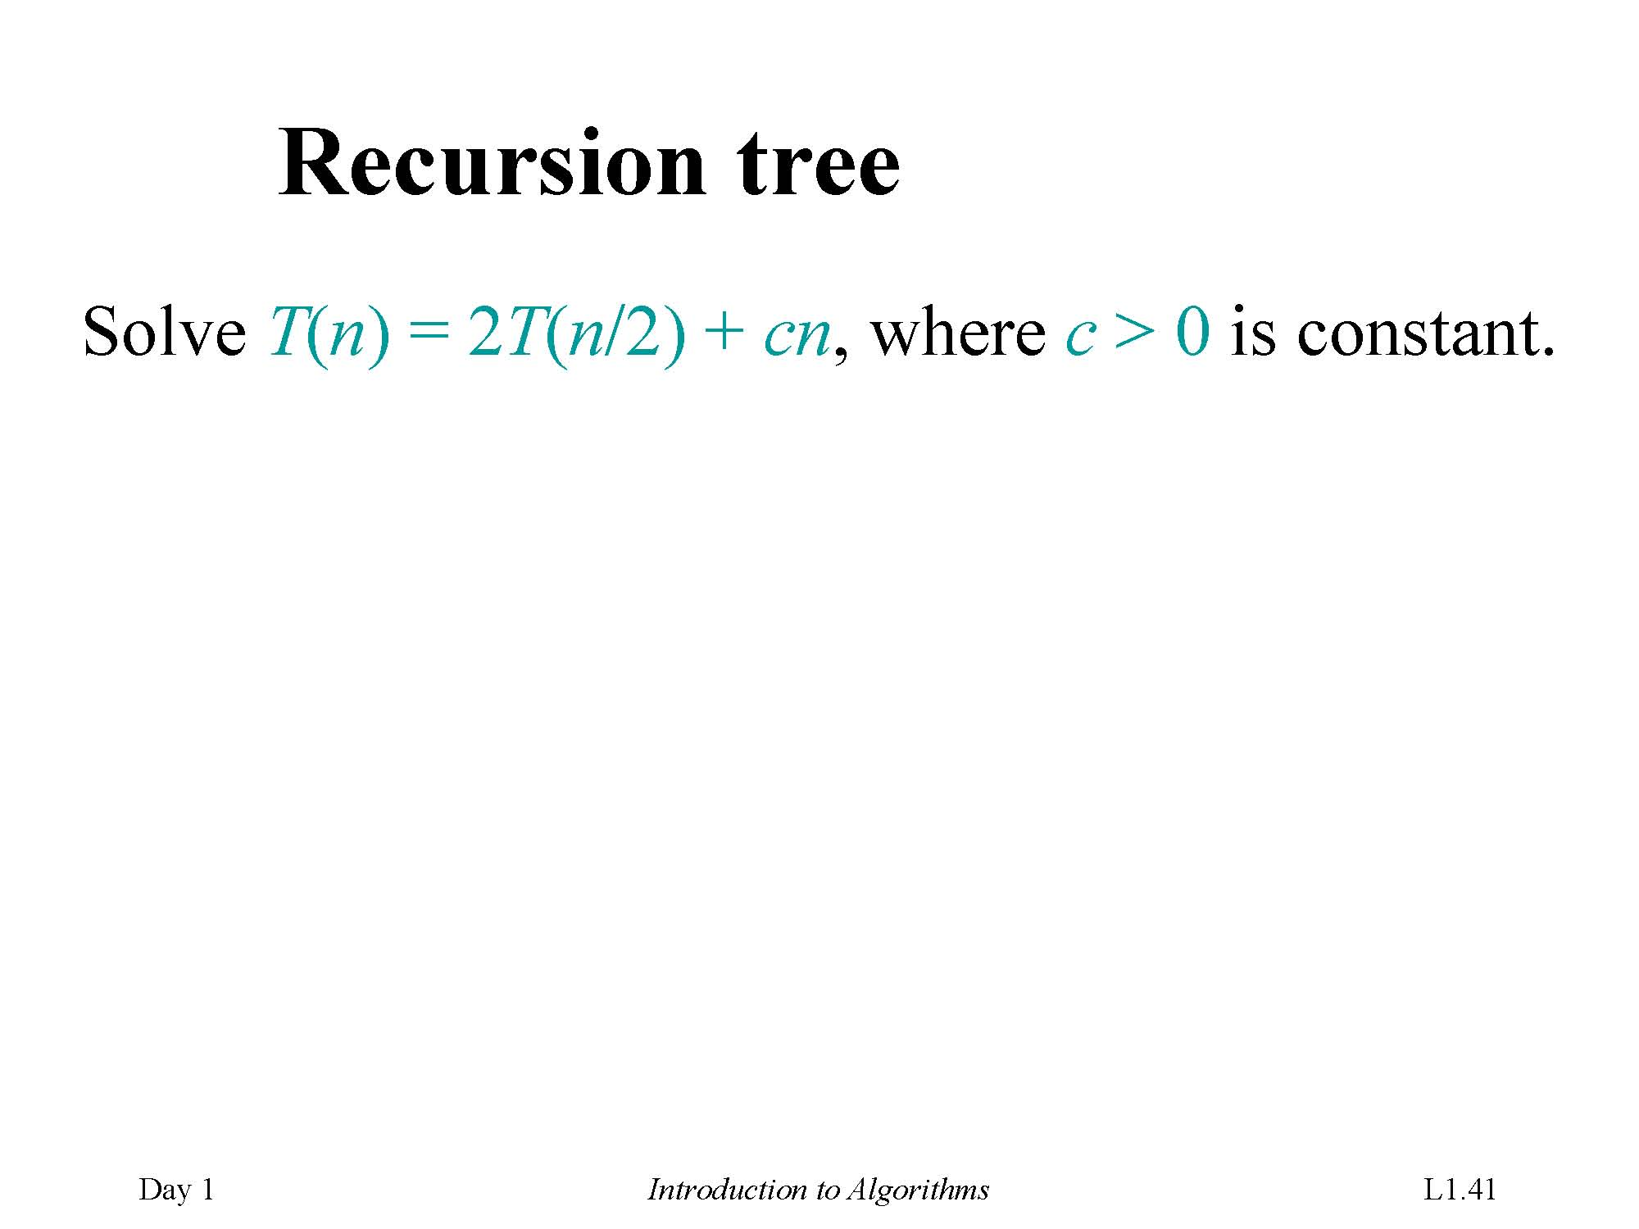

Slide 74
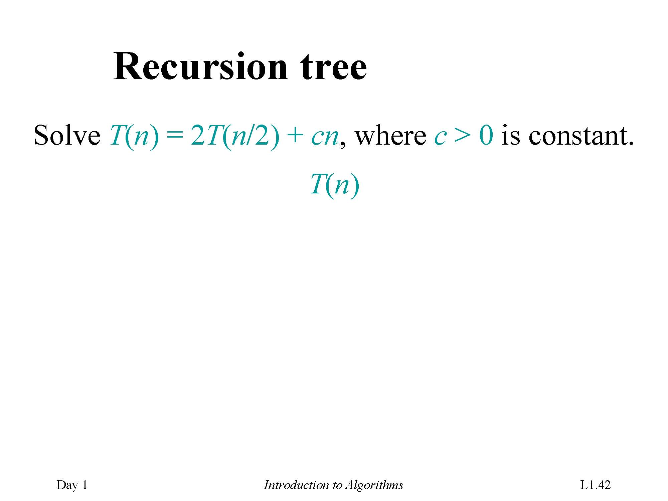

Slide 75
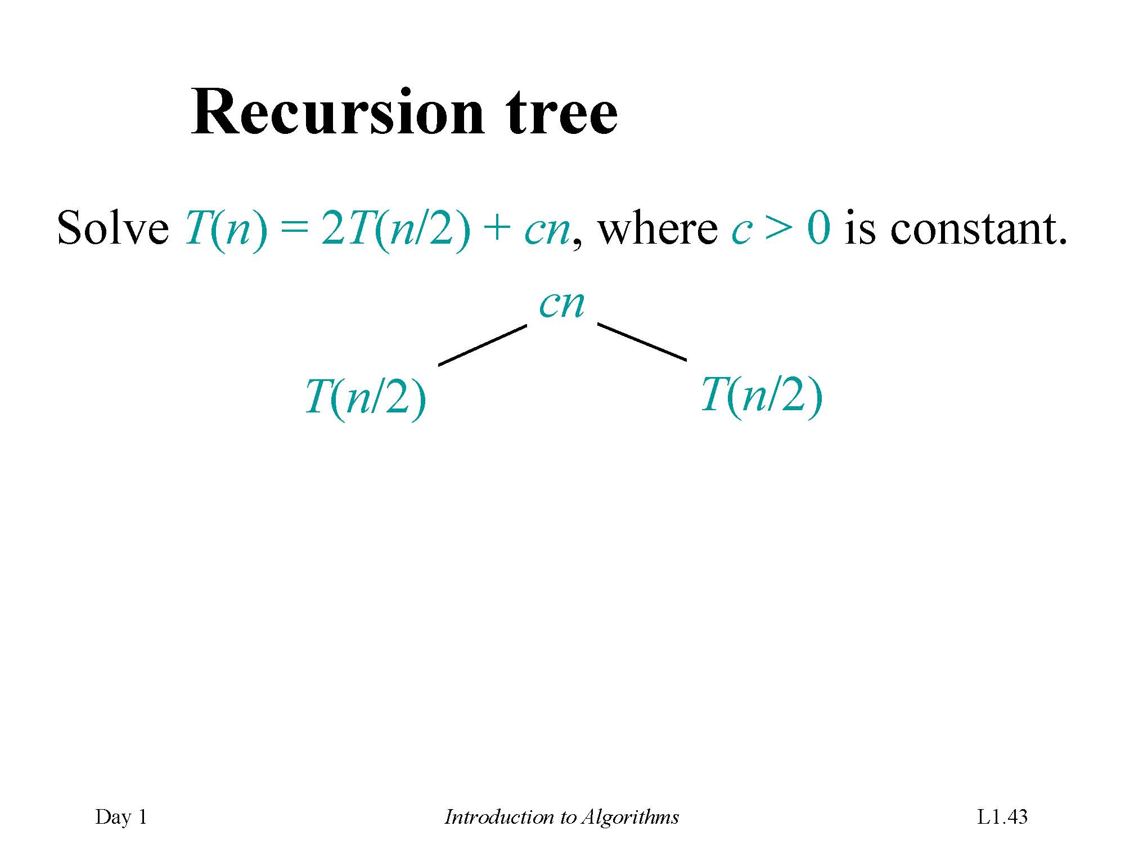

Slide 76
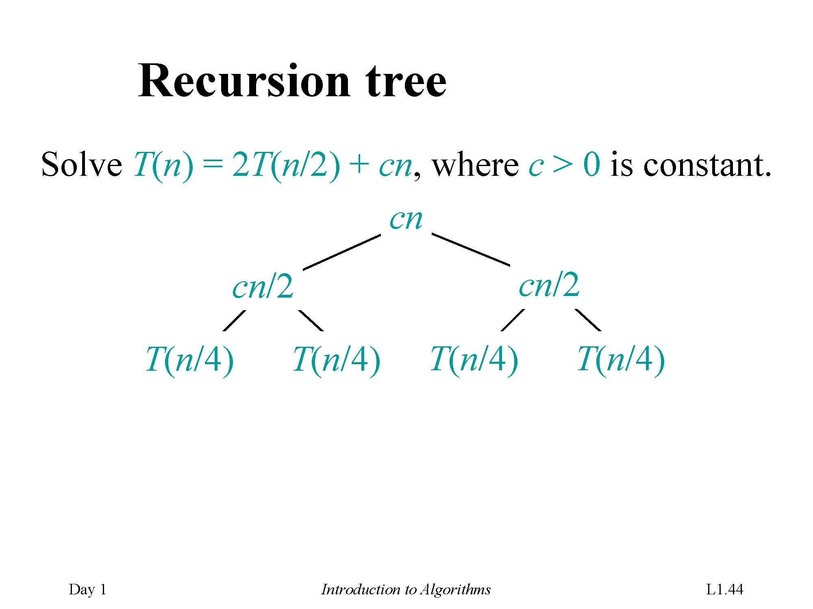

Slide 77
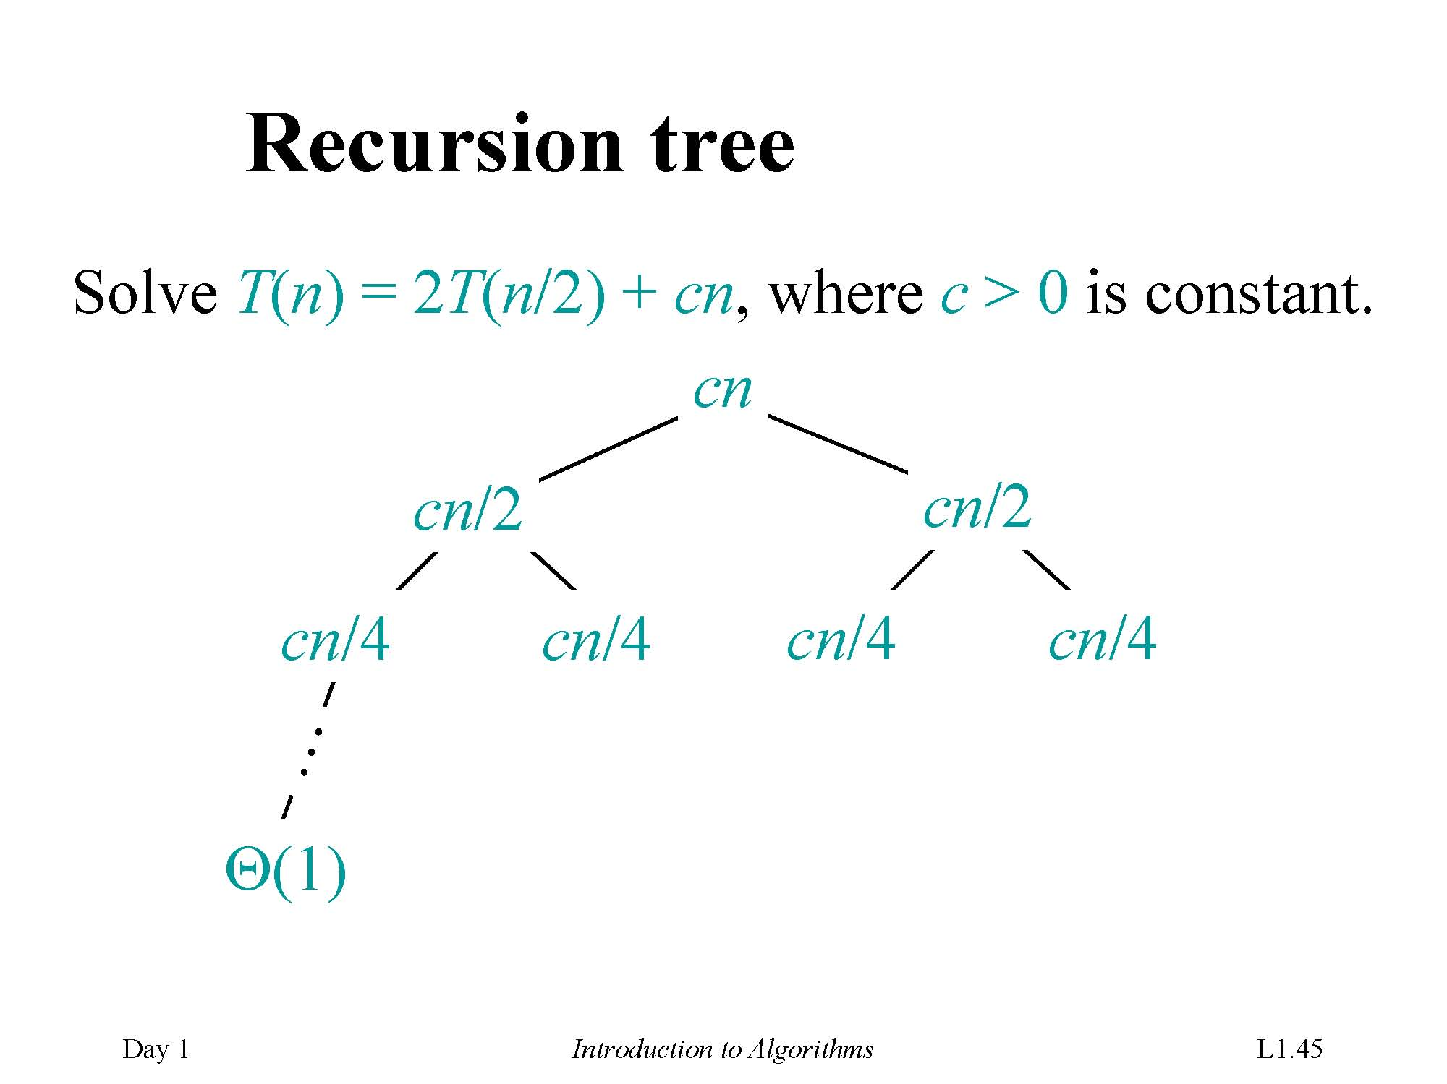

Slide 78
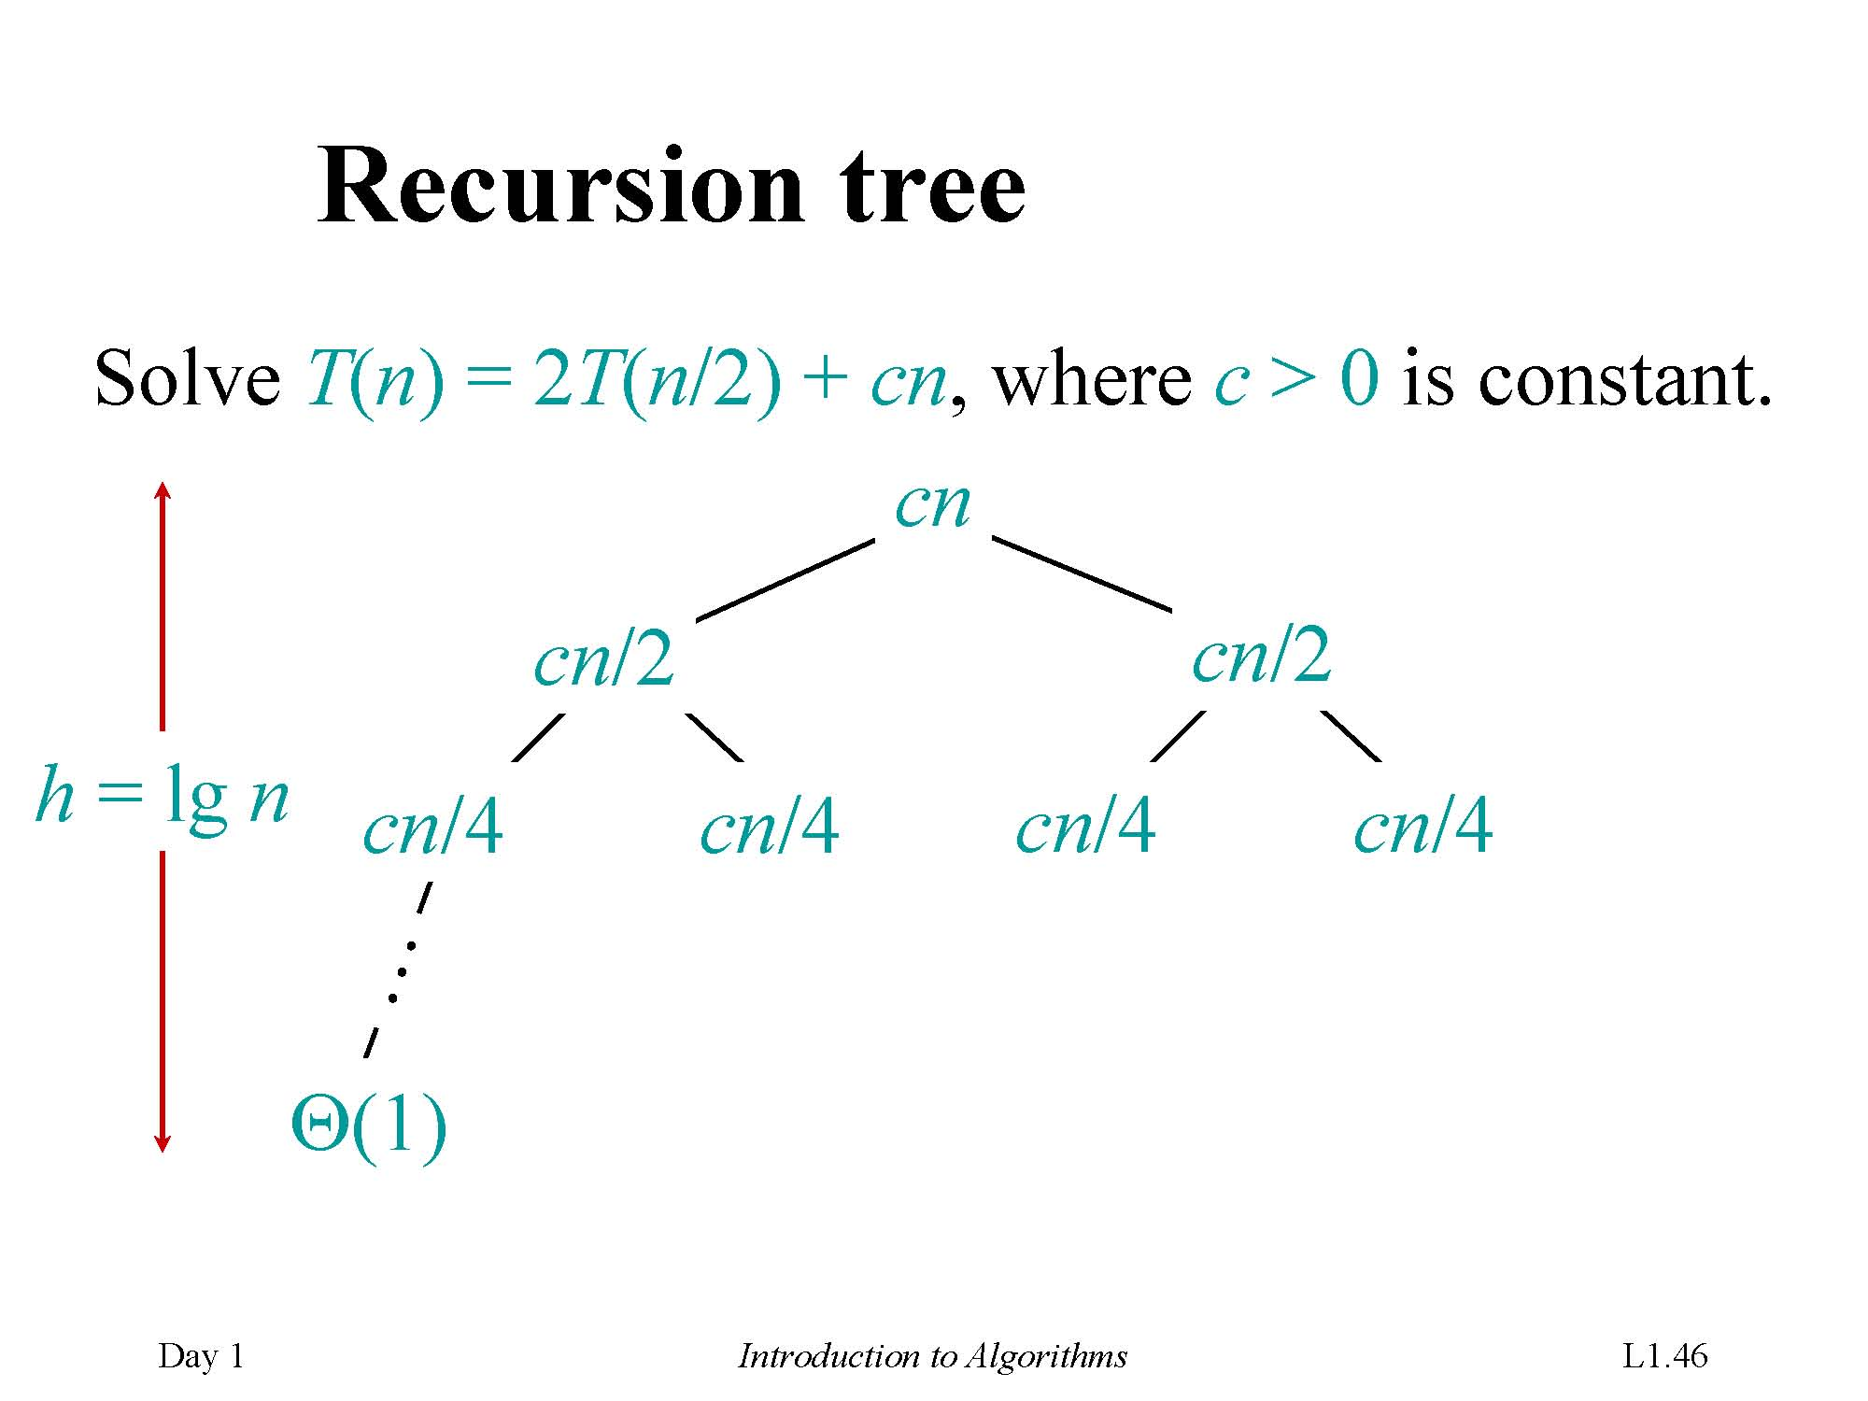

Slide 79


Slide 80


Slide 81


Slide 82


Slide 83


Slide 84

Induction

Slide 85
Each level has cost cn.
The top level has cost cn.
The next level down has 2 subproblems, each contributing cost cn/2.
The next level has 4 subproblems, each contributing cost cn/4.
Each time we go down one level, the number of subproblems
Total cost is sum of costs at each level. Have lg n +1 levels, each costing cn ⇒total cost is cn lg n + cn.
Ignore low-order term of cn and constant coefÞcient c ⇒(n lg n).

Slide 86


Slide 87
Exercises
2.1-2 Rewrite the INSERTION-SORT procedure, nonincreasing instead of nondecreasing order
2.2-2 Selection sort: Give the best-case and worst-case running times of selection sort …
2.3-4 Insertion sort can be expressed as a recursive procedure as follows. Write a recurrence for the running time of this recursive version of insertion sort.

Slide 88
Exercises
2.1-2 Rewrite the INSERTION-SORT procedure, nonincreasing instead of nondecreasing order
2.1-3 Linear search: sequence of n numbers, and a value v.
2.1-4 Adding two n-bit binary integers-arrays

Slide 89
Exercises
2.2-2 Selection sort: Give the best-case and worst-case running times of selection sort in Θ-notation.
2.2-3 Linear search: What are the average-case and worst-case running times of linear search in Θ-notation?
2.2-4 Best-case running time: How can we modify almost any algorithm to have a good best-case running time?

Slide 90
Exercises
2.3-3 Mathematical induction: Use mathematical induction to show that when n is an exact power of 2, the solution of the recurrence T(n)=2T(n/2)+n,T(2)=2 is T(n)=nlgn.
2.3-4 Insertion sort can be expressed as a recursive procedure as follows. Write a recurrence for the running time of this recursive version of insertion sort.

Slide 91
End of Chapter
《算法分析与设计》课程组
重庆大学计算机学院

Slide 92
Pseudocode conventions
Indentation indicates block structure:
Clarity
Similar to those in Pascal
The looping constructs:
while, for, and repeat
the conditional constructs:
if, then,and else
The symbol "▹" indicates that the remainder of the line is a comment.
A multiple assignment of the form i ← j ← e
Array elements A[1..j]=A[1], A[2], . . . , A[j].

